Slide 1

Step Two: Import Contacts

Slide 2

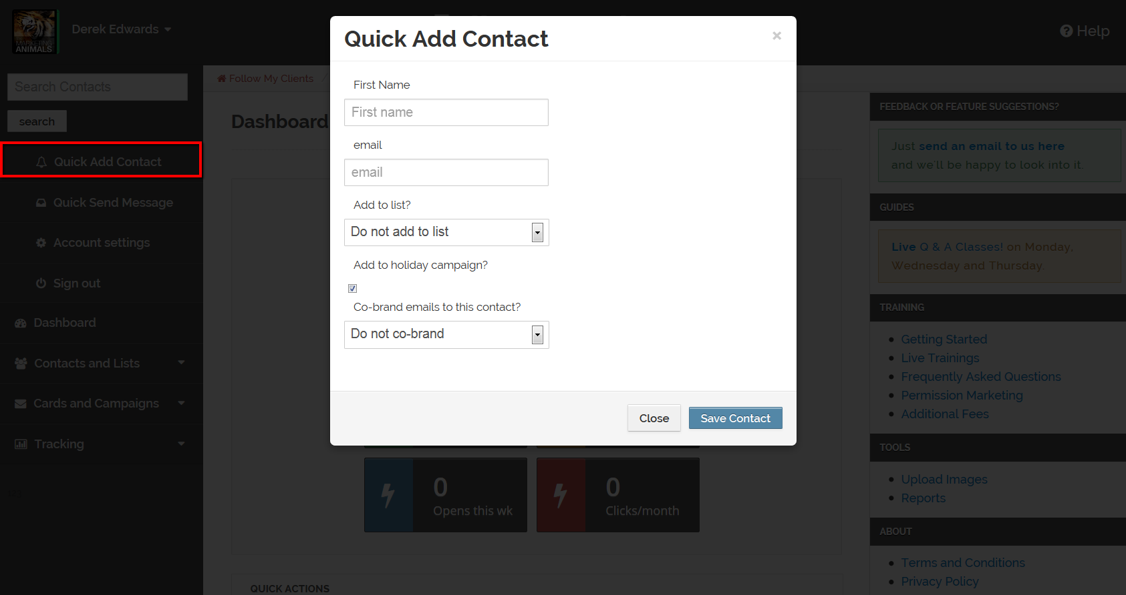
As mentioned in Step One, you can Quick Add Contacts one at a time. Adding contacts this way will only require input of the necessary information to market with.

Slide 3
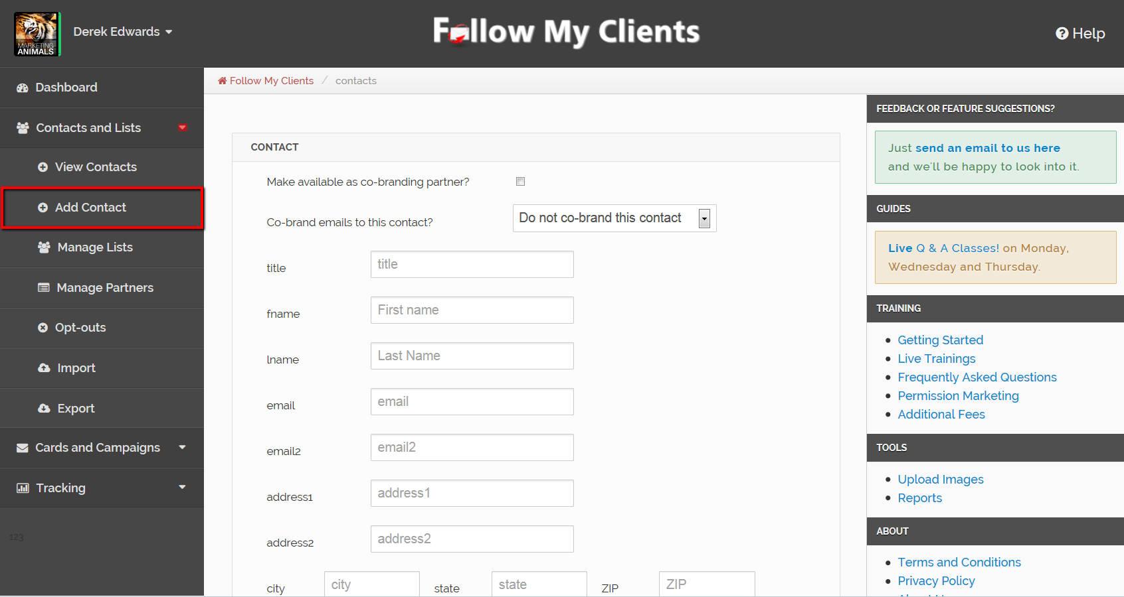
If you would like to use Follow My Clients as a database manager, you can add contact information in depth by selecting Contacts and Lists and then Add Contact.

Slide 4
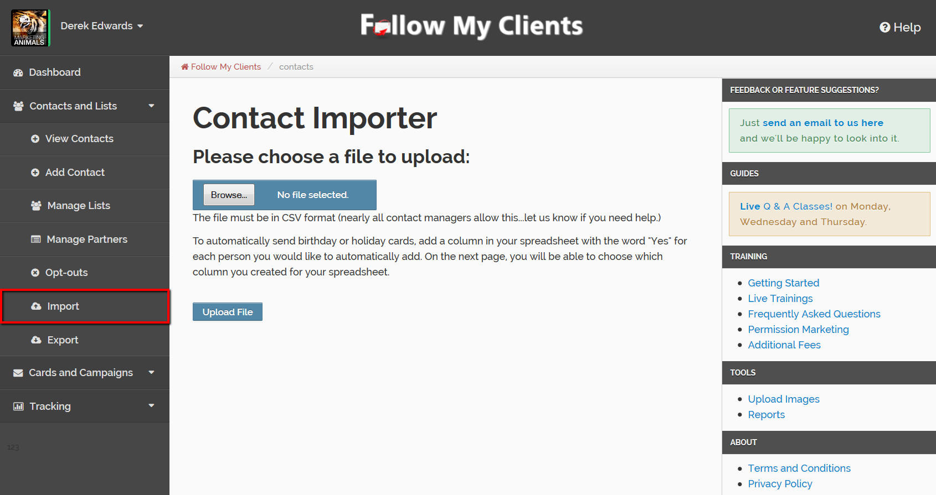
You can also add your contacts in mass by importing from an Excel CSV spreadsheet. Just like Follow My Clients, most programs that hold your database currently will allow you to export onto an Excel spreadsheet. Export your contacts from any program that holds your database currently. Such as Gmail, Outlook and Linkedin.

Slide 5
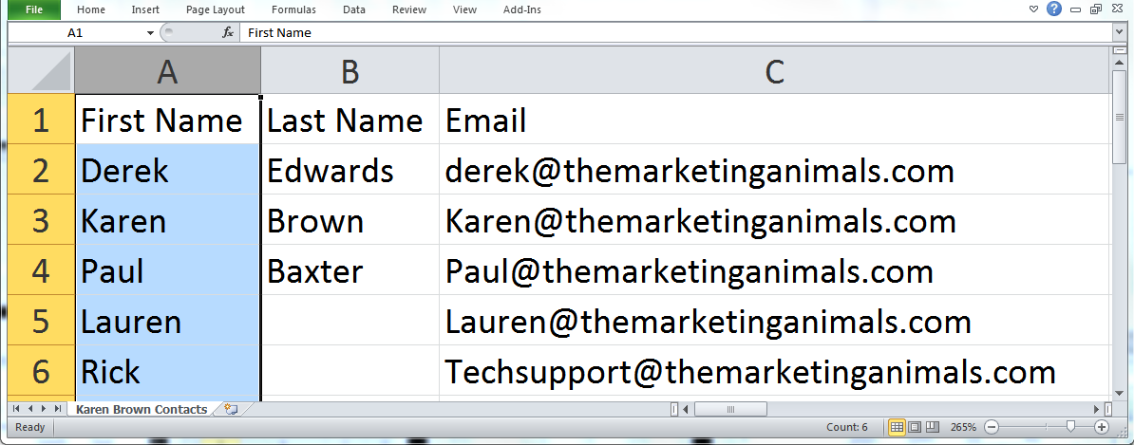
Prospects
Clients
Realtors
Partners
I recommend spending
some extra time to gather all of your
contacts currently and organize them by category. The easiest way, create separate Excel spreadsheets for each type of database you are trying to market to.
One for Prospects, one for Clients, one for Realtors, Partners, or however you would like to keep your contacts organized. Creating these group lists now will help you manage your contacts and allow you to send target messages to each audience.
There are a lot of tutorials online that can help you manipulate Microsoft Excel.

Slide 6
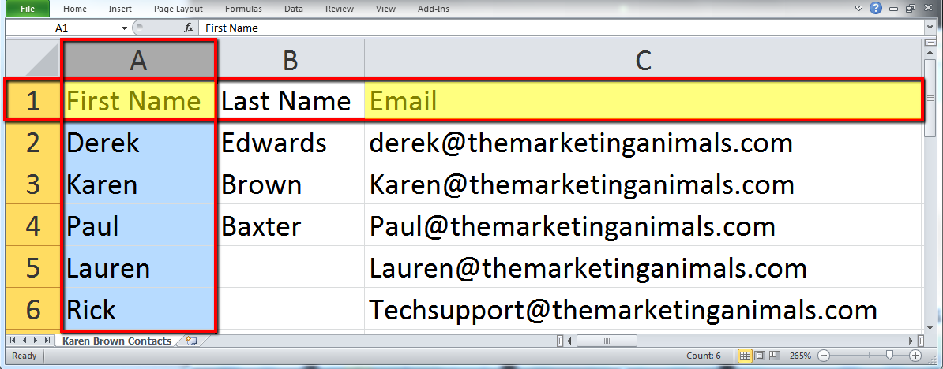
You just need to make sure that the contact information on the Excel spreadsheet is separated by columns and headers.
Also, you must make sure that the information in the First Name and Email columns are correct and free from special characters (< - : ; , ‘’ >). The first name column on this spreadsheet will be pulled for the greeting on every email sent and if an email is invalid you won’t be able to market to it.

Slide 7
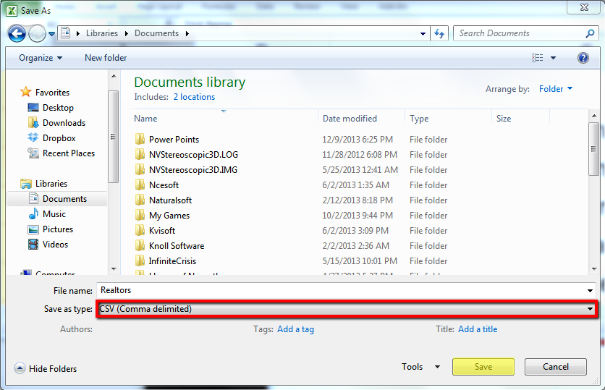
Then “Save As” a CSV document.

Slide 8
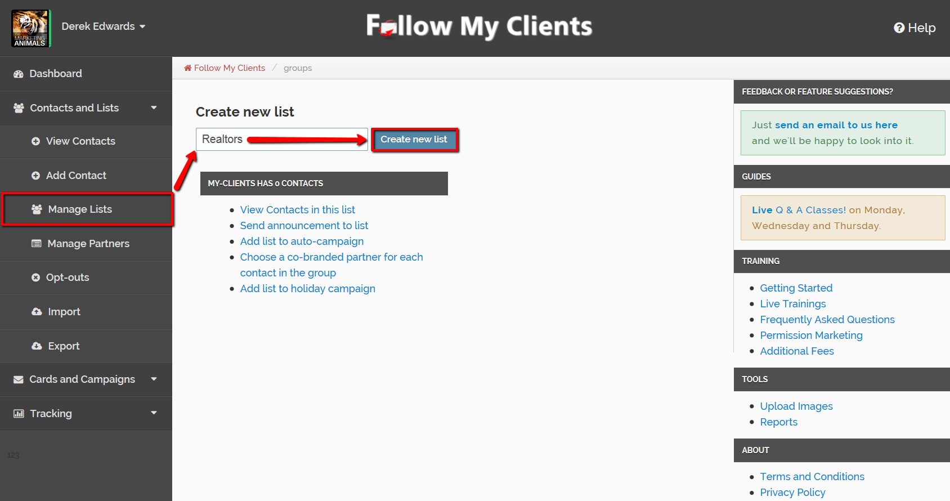
Once you have those separate spreadsheets, you can import them one at a time into your account. Before we import, create those lists inside Follow My Clients so that we can filter the contacts.
To do that, select Contacts and Lists and then select Manage Lists. Create the list name for those contacts you are about to import.

Slide 9
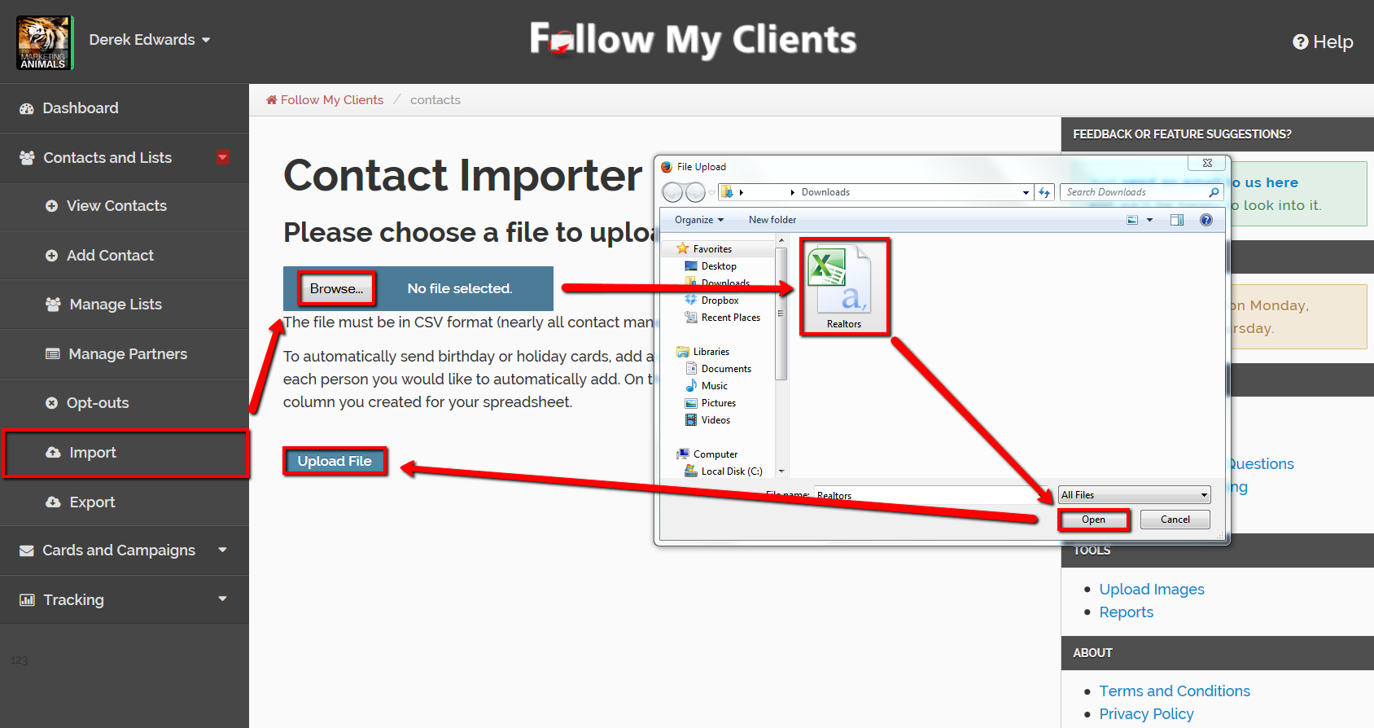
Once you're done, select Contacts and Lists again, then select Import. Browse for your spreadsheet, select the file and open it.
Upload the File.

Slide 10
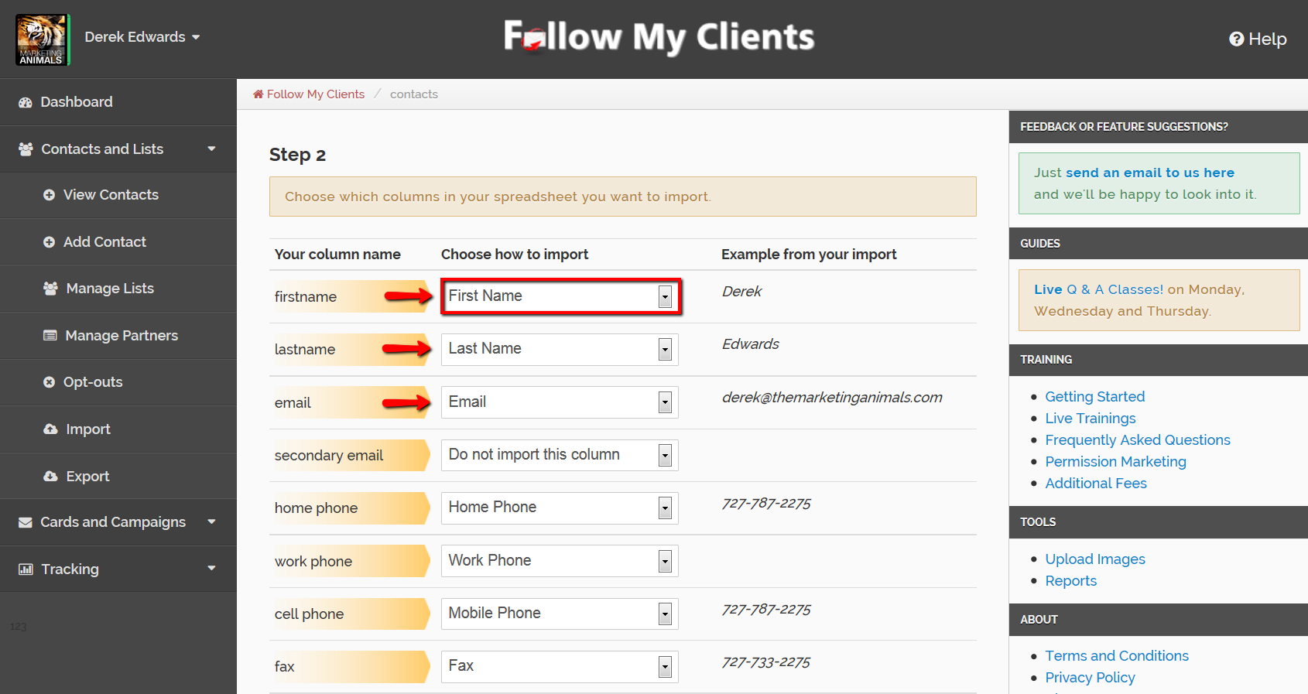
You will now see your spreadsheet column header names on the left and to the right of them you will see a drop down box. You will have to use that to find a similar title that Follow My Clients accepts. If you cannot find a similar title, then you can choose to not import that column. Begin to correct your column headers.

Slide 11
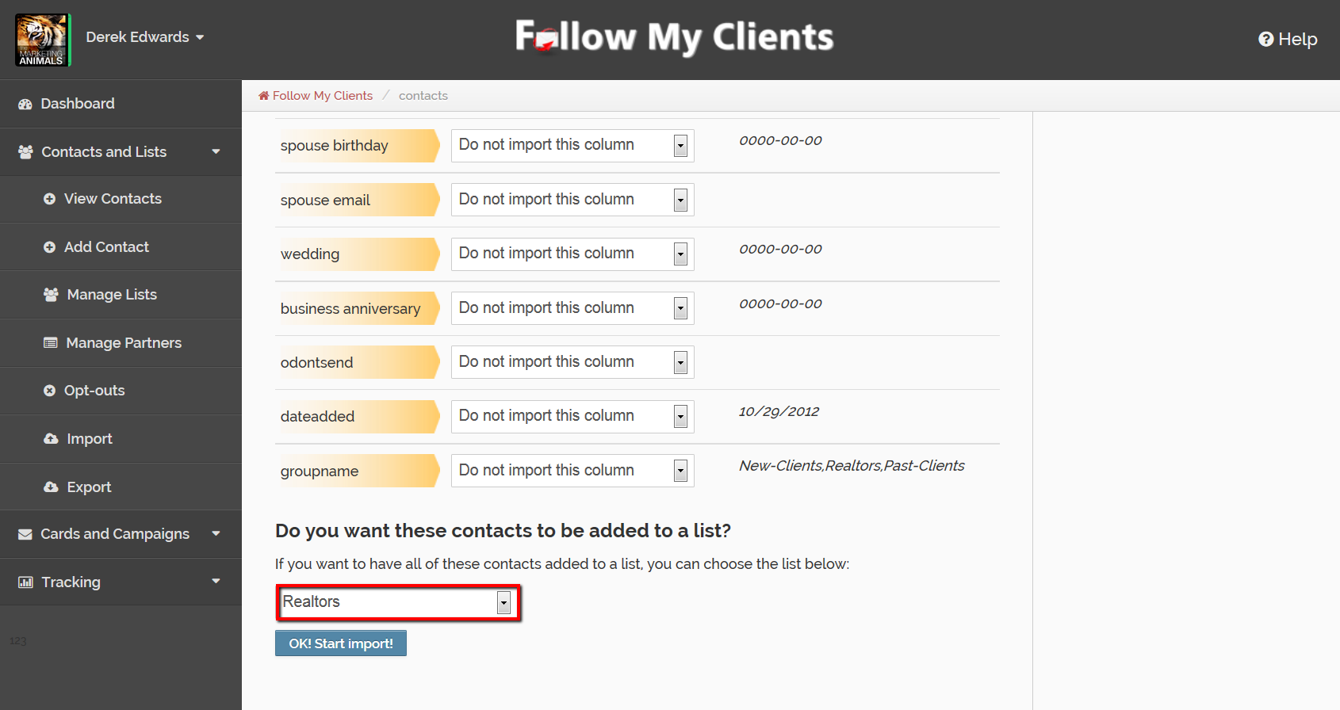
After you’re done, make sure to add this spreadsheet to your already created list, then Start Import!

Slide 12

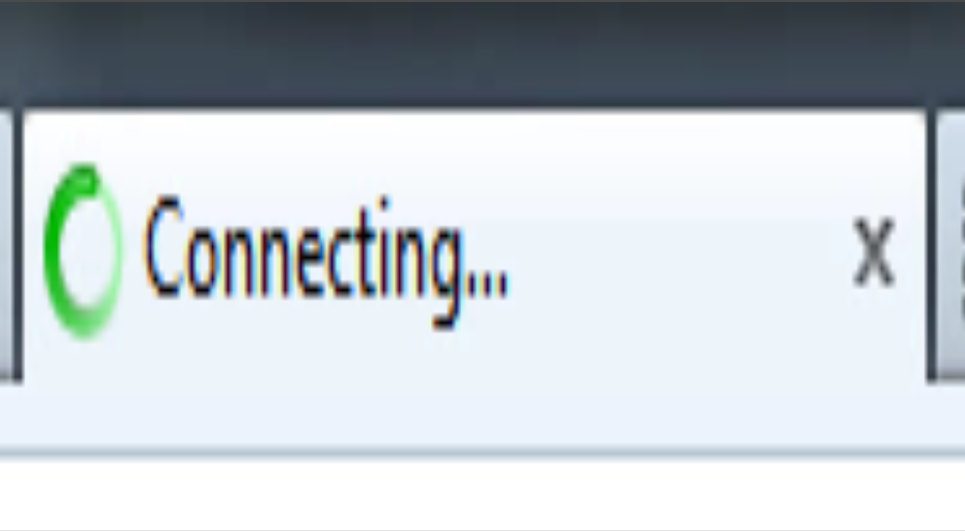
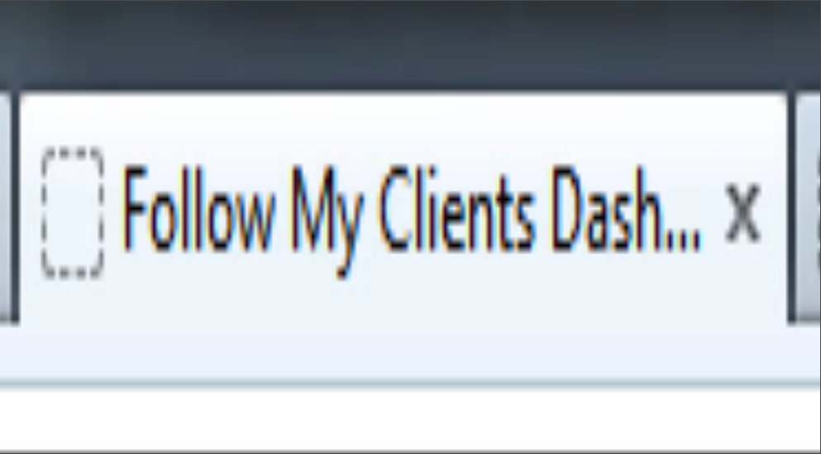
Wait until your browser page fully loads before exiting or redirecting from the page.

Slide 13
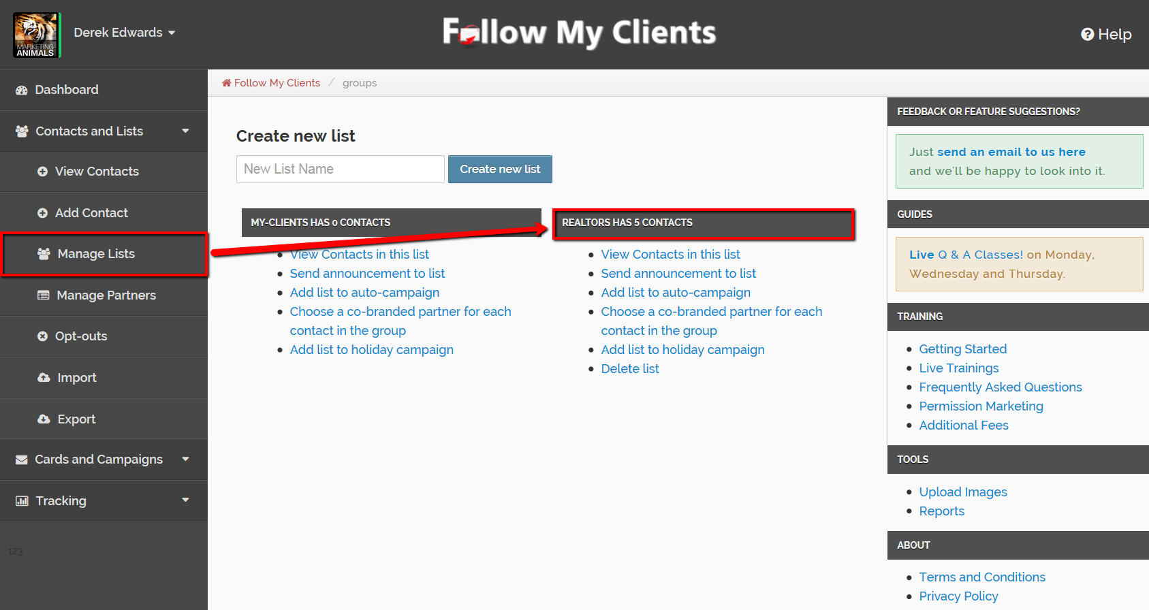
Once it finishes loading, you can select Contacts and Lists once again, then Manage Lists to confirm your import.

Slide 14

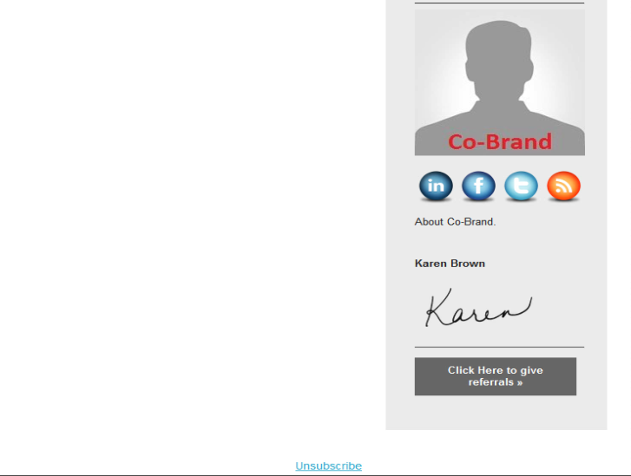
Now that you have imported your database. You can begin to Co-brand with your Partners.
Follow My Clients allows you to co-brand emails. This is a huge advantage to building partner relationships. You would offer this service to your partners for free and in return, you will have access to co-brand yourself with their entire database. Increasing your reach.

Slide 15
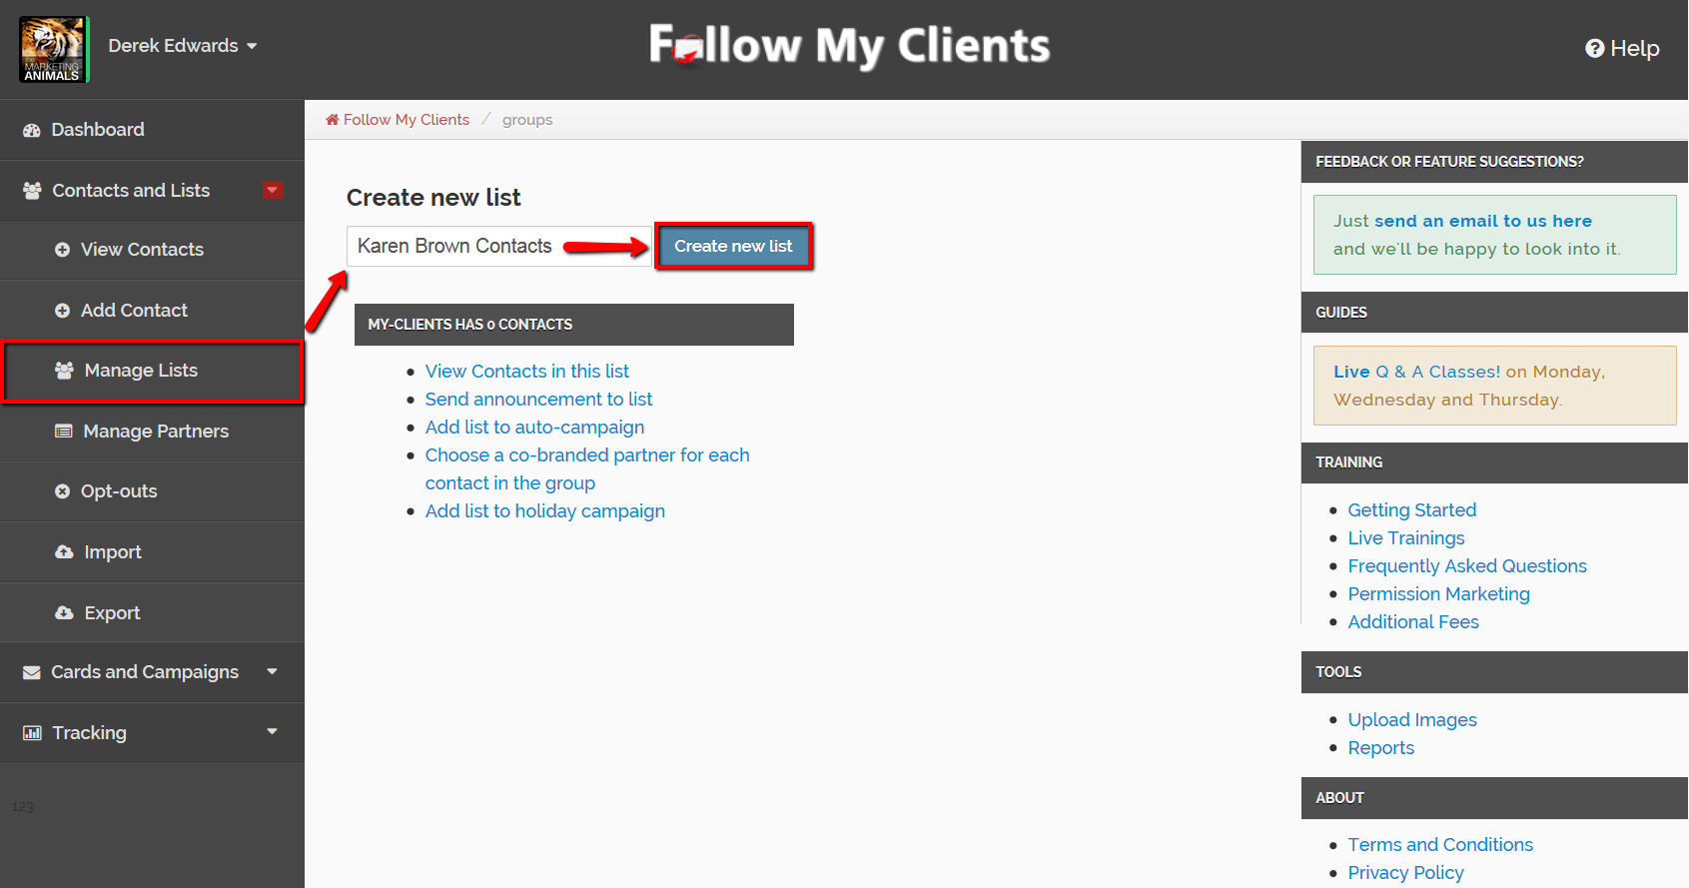
Before you add the co-brand you will need to create a list for their contacts.
To do that, click on the Contacts and Lists, then Manage Lists. Create a list for your co-brand partner.

Slide 16
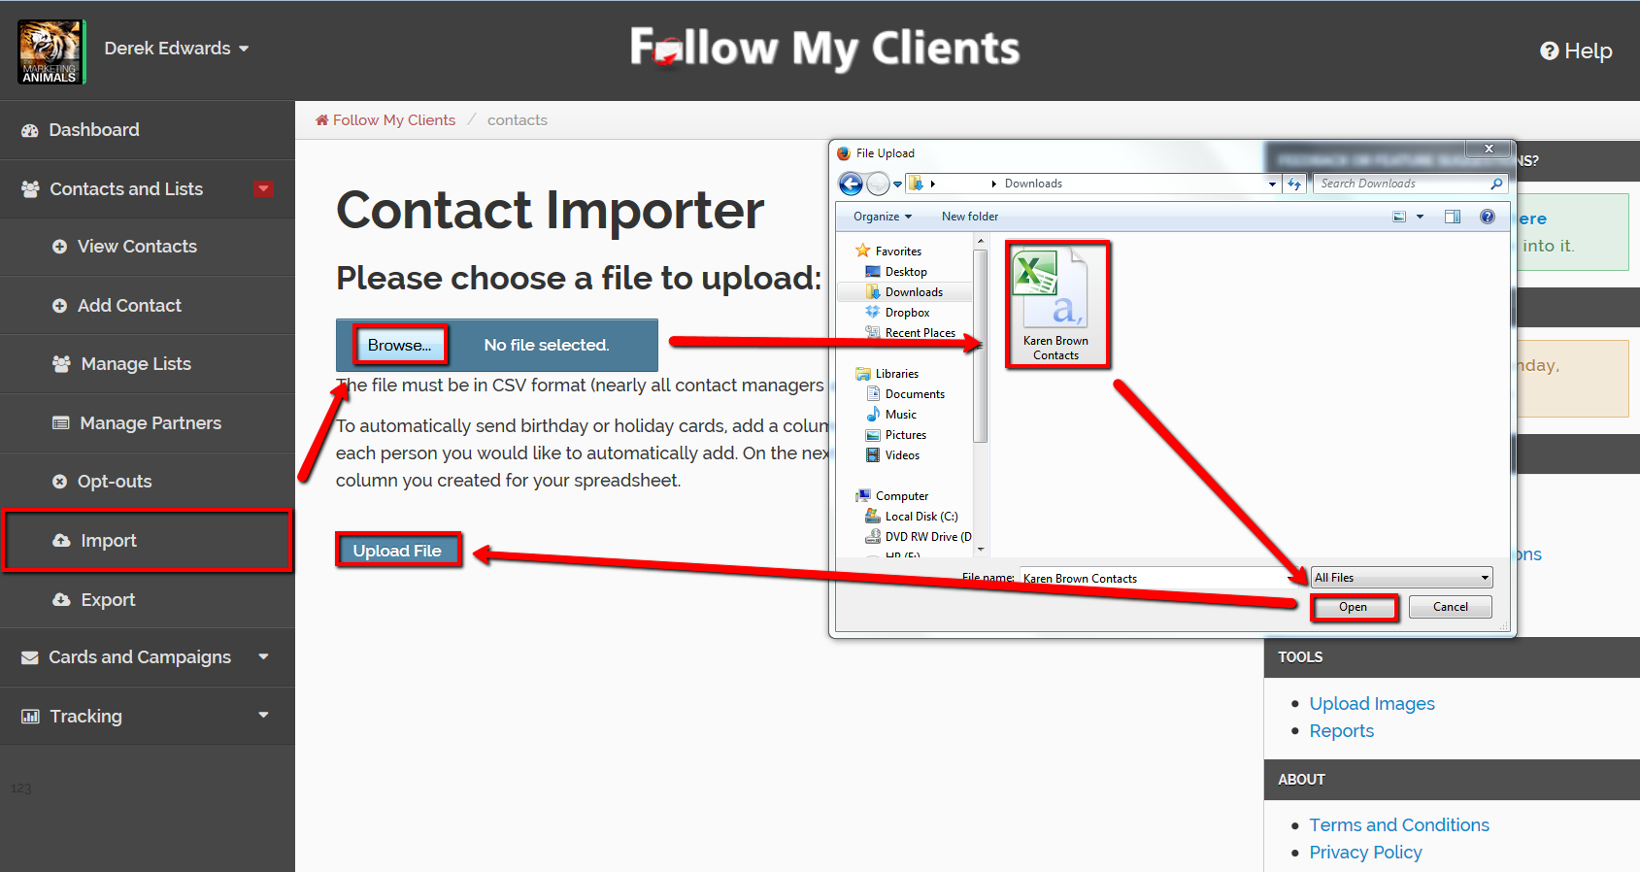
Then import their database.

Slide 17

Make sure to add the contacts to the already created list. Then Start Import.

Slide 18

Next, add the co-brand as a contact. At the top select the box for “Make Available as co-branding partner”.

Slide 19
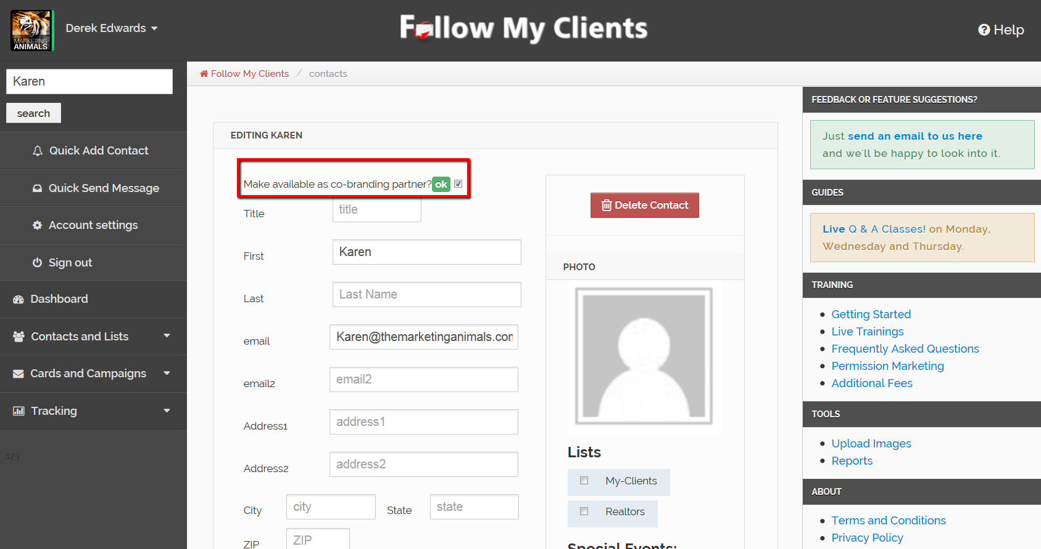
If the co-brand is already inside the account then search, view the contact and then edit contact. On the contacts profile page, select the box for “Make available as co-branding partner”. Repeat Step One to include the co-brands contact information and picture.

Slide 20
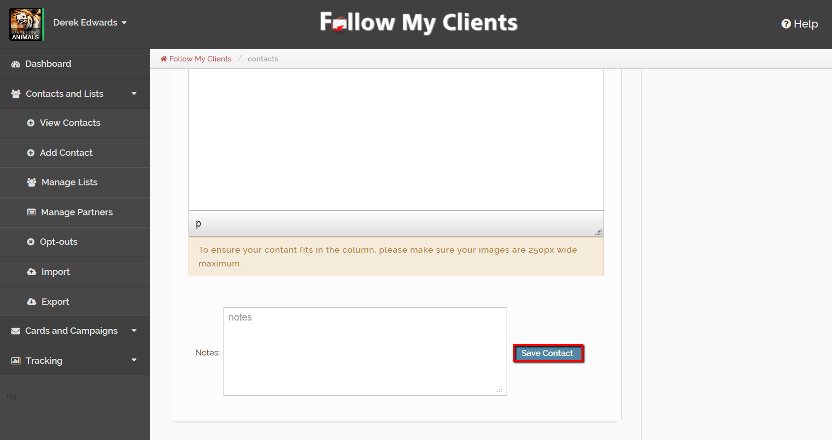
Once you are done, click “Save Contact” at the bottom.

Slide 21
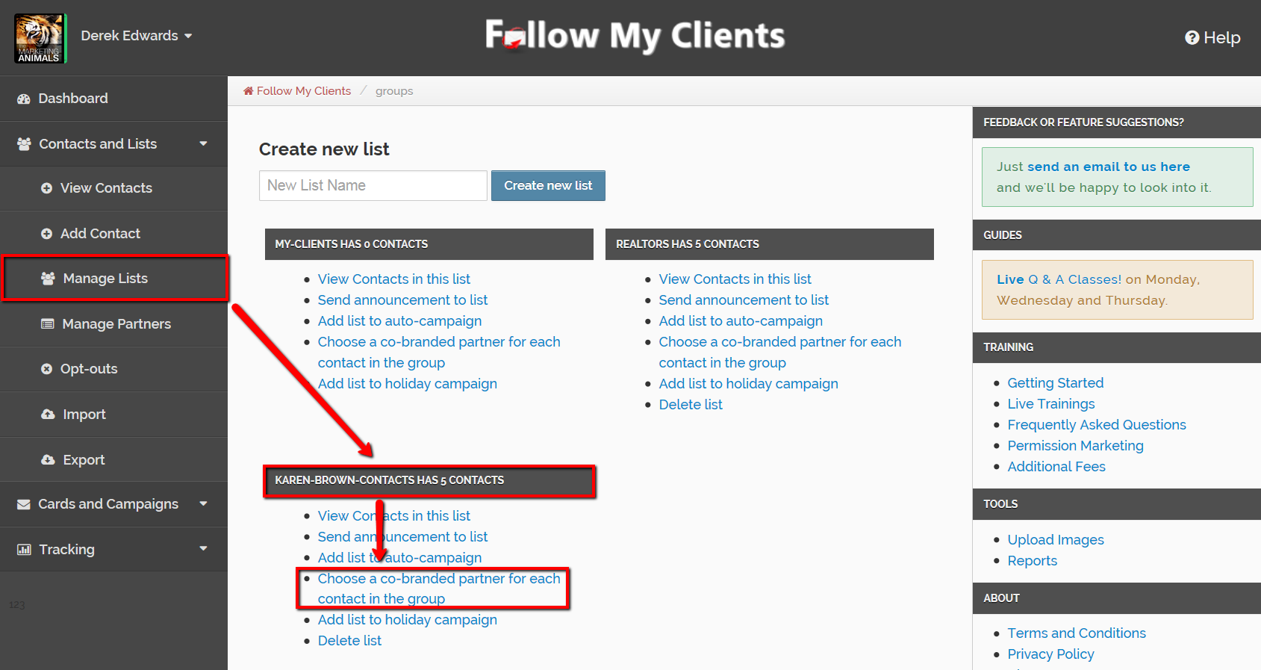
You need to apply this co-brand to the list of co-brand contacts by clicking Contacts and Lists, Manage Lists, then under every list there will be a hyperlink for “Choose a co-branded partner for each contact”.
Click there.

Slide 22
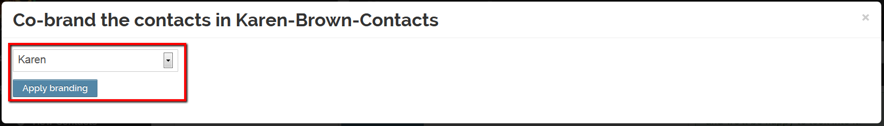
Select the cobrand then “Apply branding”. Wait for your page to fully load.
Now emails sent to this list will include the partners information on the branding template.

Slide 23
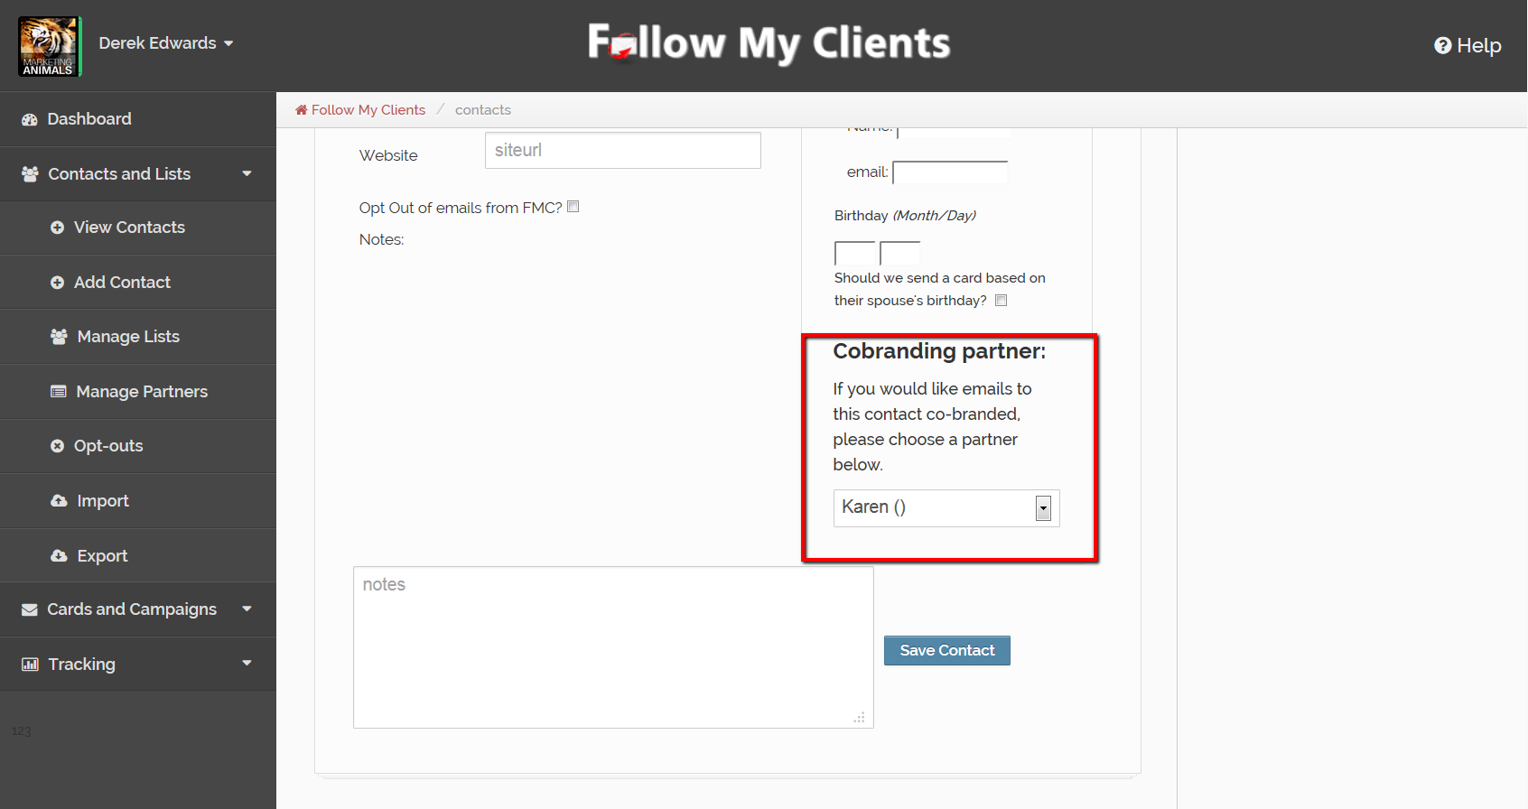
You can also add the co-brand to your contacts one at a time if you edit the contacts profile page.

Slide 24
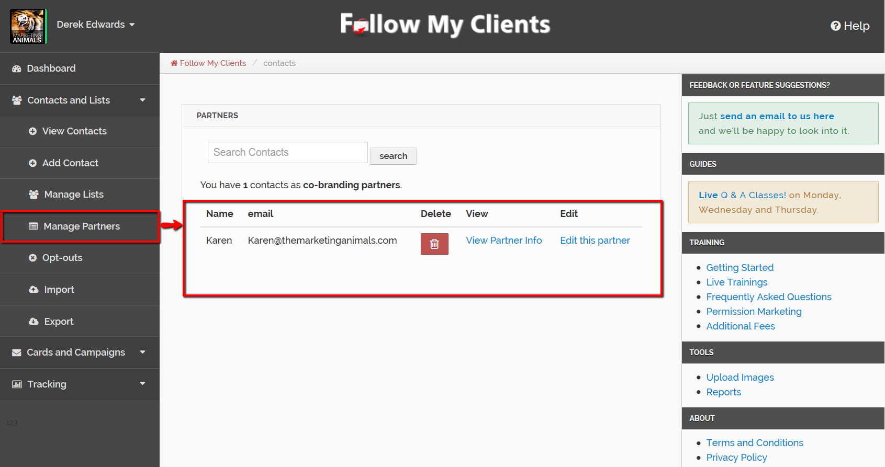
You can view and edit your cobrand partners at any time by clicking Contacts and Lists then Manage Partners.

Slide 25
Import Complete!
Before moving on to Step Three, import all of your current contacts and Co-Brand Partners.

