Slide 1

Step Four: Campaigns & Tracking

Slide 2

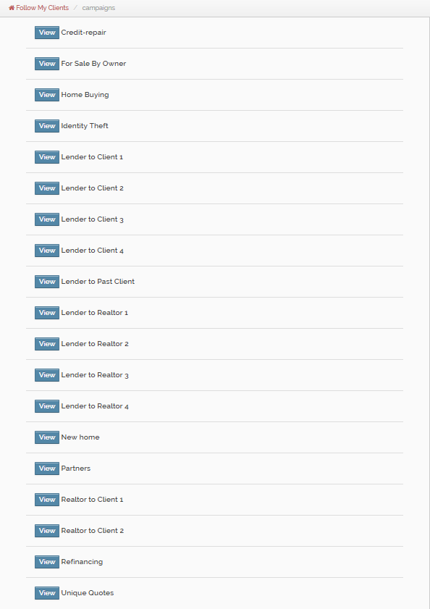
Follow My Clients is best known for our pre-written done for you email campaigns, most of which are targeted around the Mortgage/Real Estate industry. You have control of setting them up to be sent out automatically every week on the day of your choosing.
Campaigns range in a variety of topics and length. Once a campaign expires you will have to log into your account to apply a new one.

Slide 3
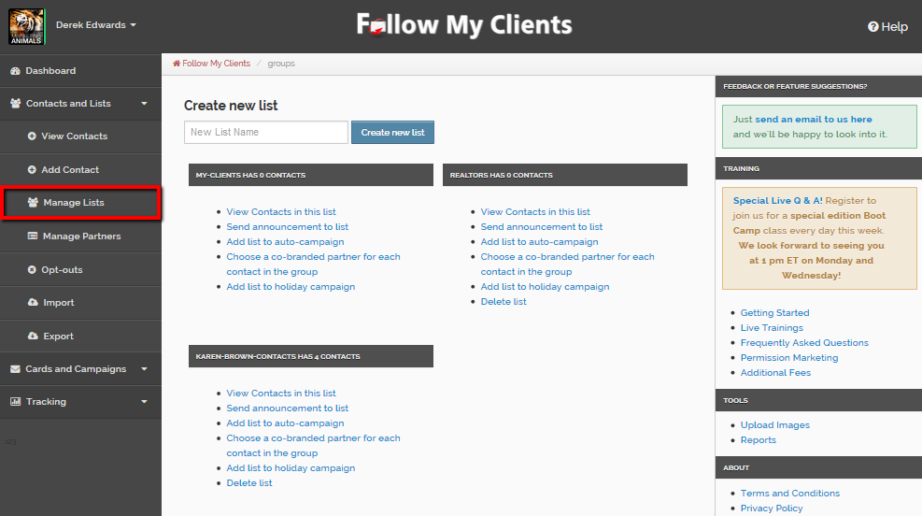
As mentioned in Step Two, it is essential to organize your contacts by list so that you can use target campaigns for each audience.

Slide 4
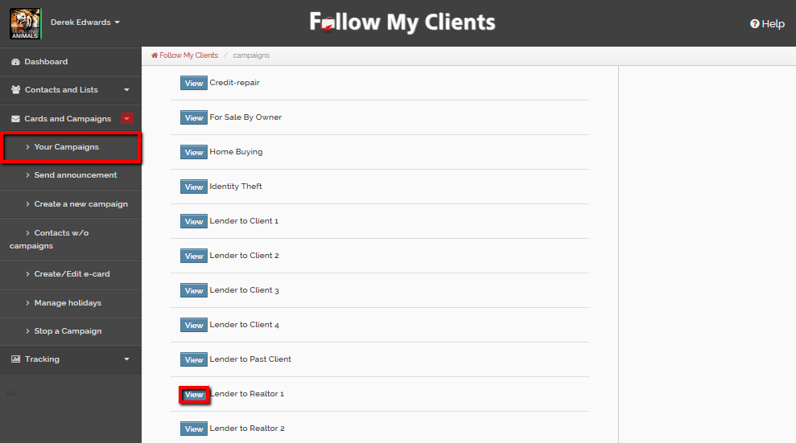
You can edit, preview and pick the campaign to use by selecting Cards & Campaigns then Your campaigns. Browse through the titles until you find a one relative to your list. Then view the campaign.

Slide 5
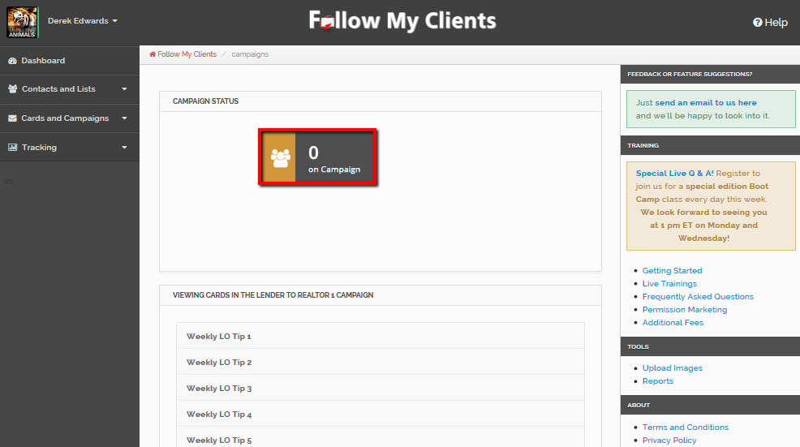
At the top you will see a trigger button for Campaign Status. This is one of the ways to track your active campaigns. It will show you the number of contacts currently on this particular campaign and if you click the button it will show you all the individual contacts that are on it.

Slide 6
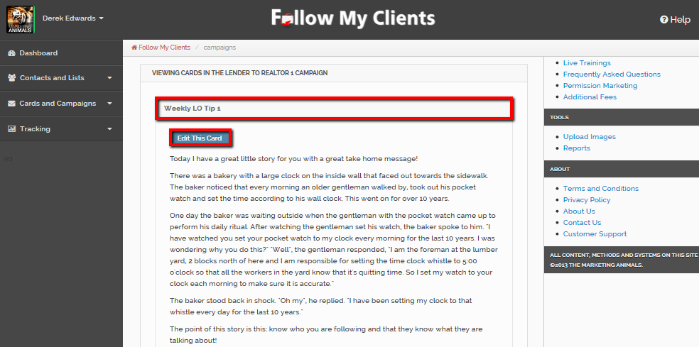
Beneath Campaign Status, you can click on the first e-card to preview and if necessary edit. If you edit any e-card in the campaign and save, Follow My Clients will create a custom duplicate of that campaign so that the original template is always saved.

Slide 7
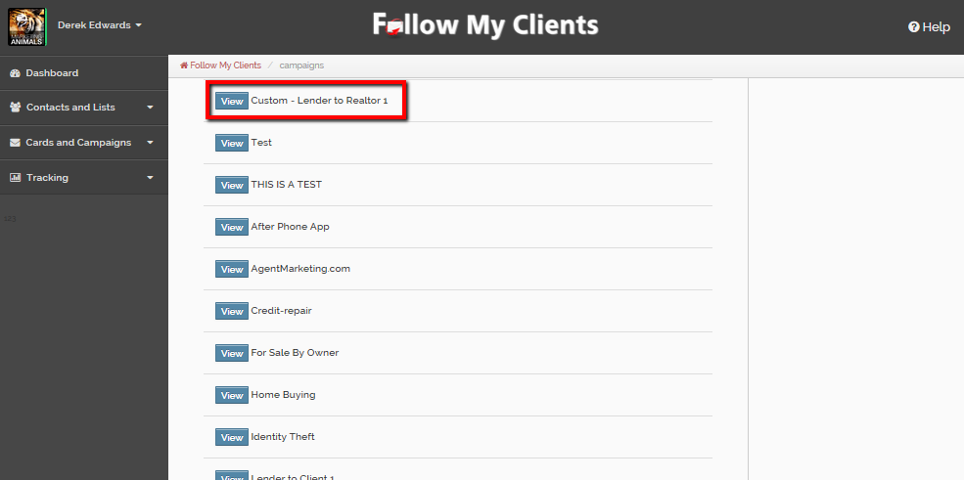
So if you do edit the campaign, make sure to apply the custom campaign to your contacts and not the original. Also, you would use your custom campaign for future edits otherwise you would create another duplicate campaign from the original.

Slide 8
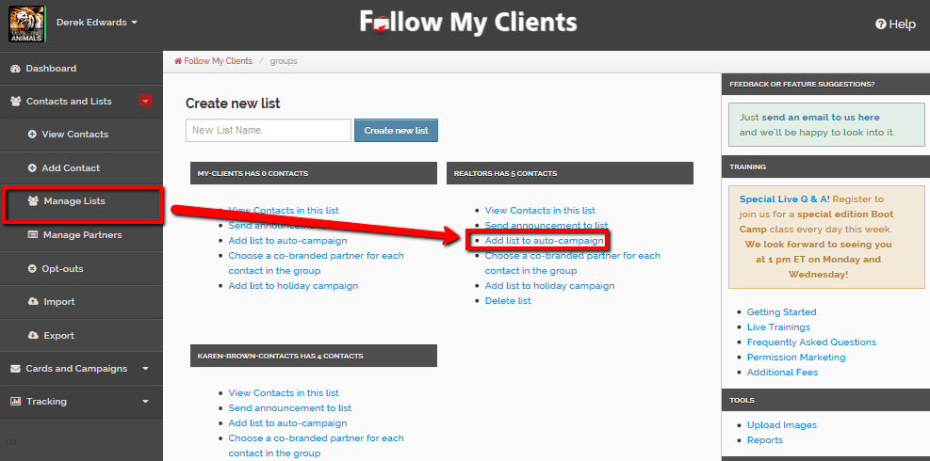
Once you have found the campaign, click on Contacts and Lists tab then Manage Lists, find the list you would like to apply this campaign to then click the hyperlink for “Add list to auto-campaign”.

Slide 9
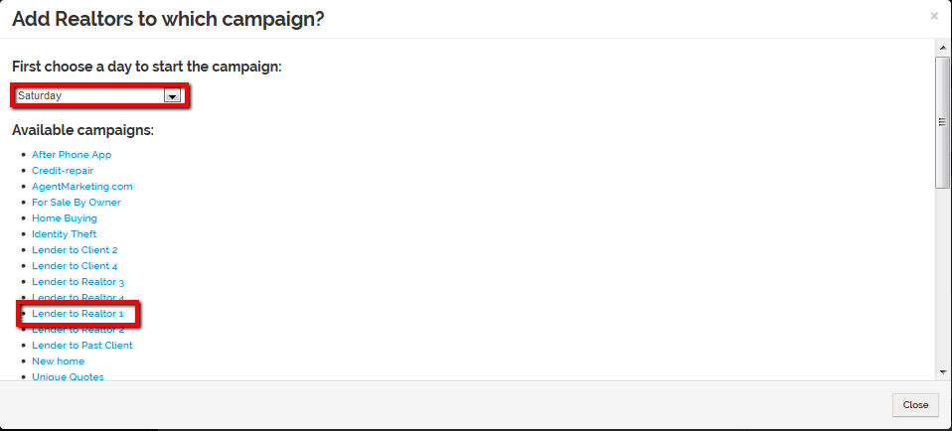
Use the drop down box to choose the day to send the first e-card and then Follow My Clients will send that campaign every week on that day until the campaign expires. Then click the hyperlink for that campaign you would like to apply.

Slide 10
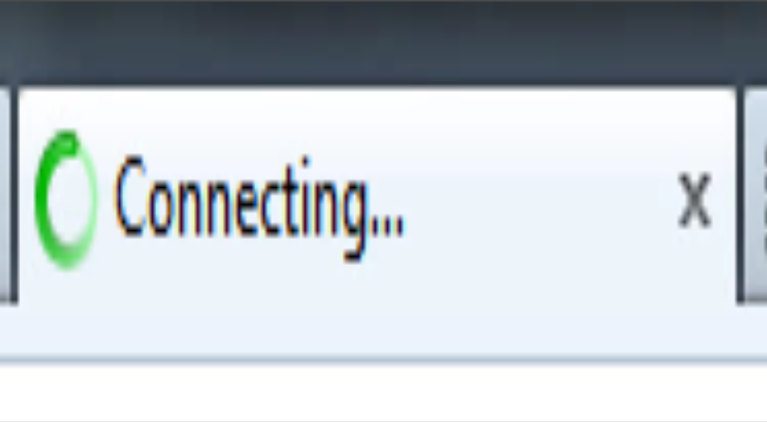
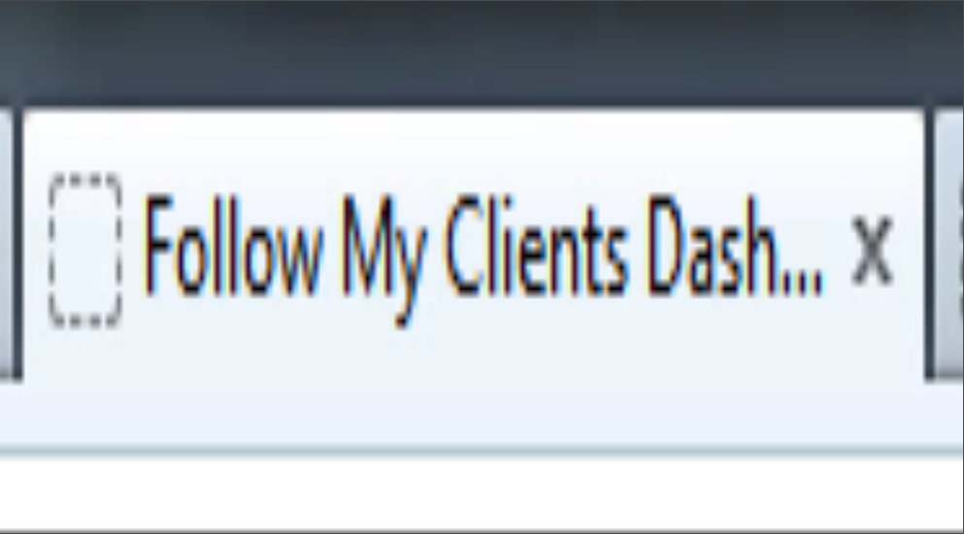
Once again wait for your page to fully load before exiting or redirecting.

Slide 11
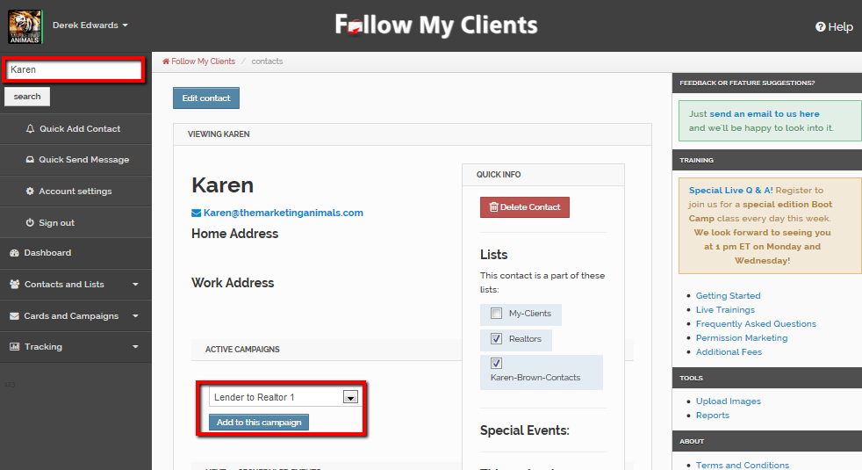
You can also apply campaigns one at a time to any individual contact by entering the contacts profile page. To do that, search for the contact and then view the contact. On the main page, select the campaign from the drop down box and then select “Add to this Campaign”. That campaign will send the following day and every week on that day there after, unless it happens to be a custom campaign with its own frequency. Once again wait for the page to fully load.

Slide 12
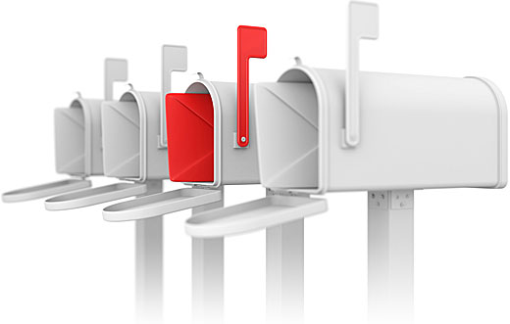
Custom campaigns allow you to build your own automatic program series using your custom e-cards or the pre-written e-cards inside your account. This is a great tool to customize your own content to send automatically.

Slide 13
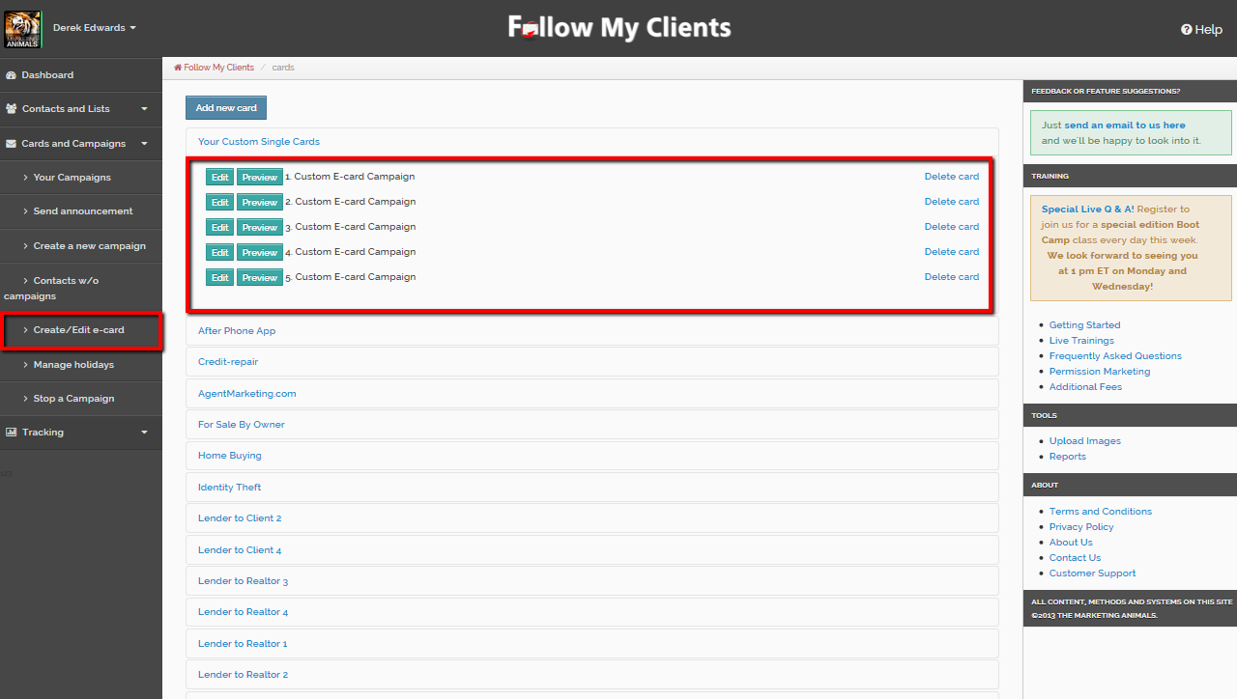
Before you create the custom campaign, you will have to create all the custom e-cards prior to building the custom campaign. You can refer back to Step Three on e-card creation.
Once you have those e-cards created, count the number of e-cards you are planning to use for your custom campaign including any pre-written e-cards inside your account.

Slide 14
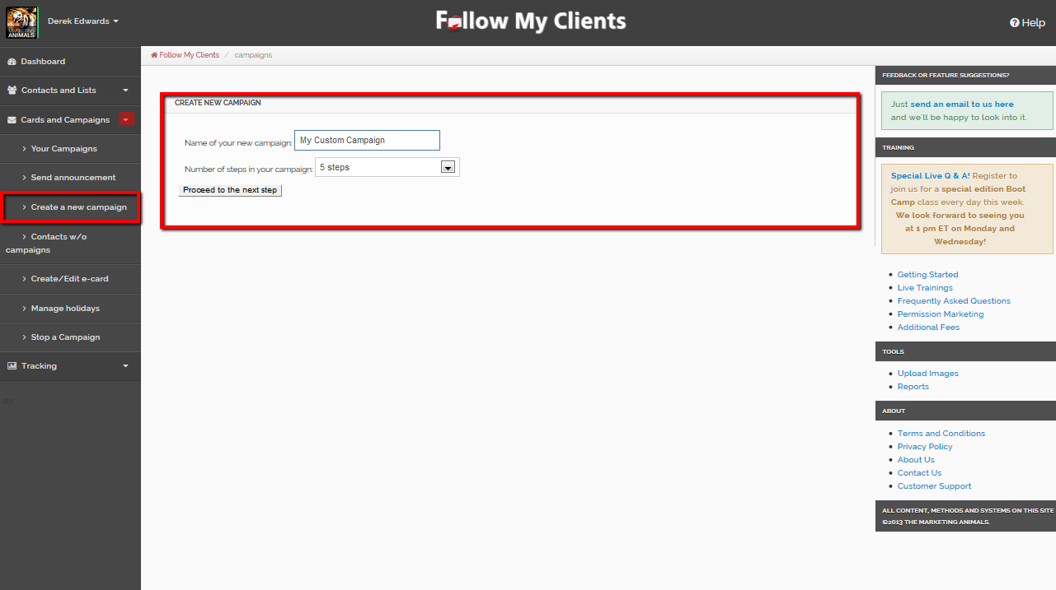
When you are ready to create your custom campaign, select Cards and Campaigns tab then “Create a new campaign”. Follow the steps. Name the Campaign, then select the number of steps for the campaign. Select “Proceed to the next step”.
Currently, the maximum number of steps is 30, if you need more steps you will have to create a second series of that campaign.

Slide 15
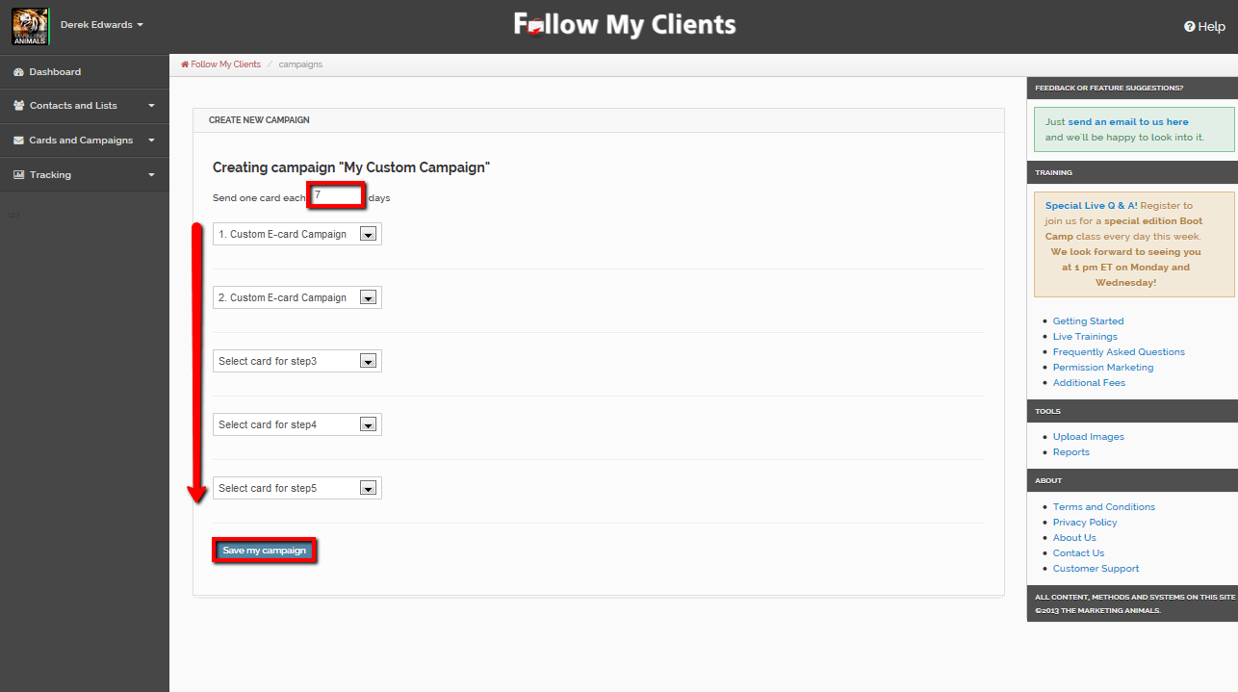
At the top, enter in the frequency for this campaign. Currently, the default is set to be sent every 7 days after you set it up to be sent. For example, if you would like this campaign to be sent bi-weekly enter in 14. Then use the drop down boxes underneath to select your e-cards in the order to be received.
Once you are done, select “Save my campaign” at the bottom.

Slide 16
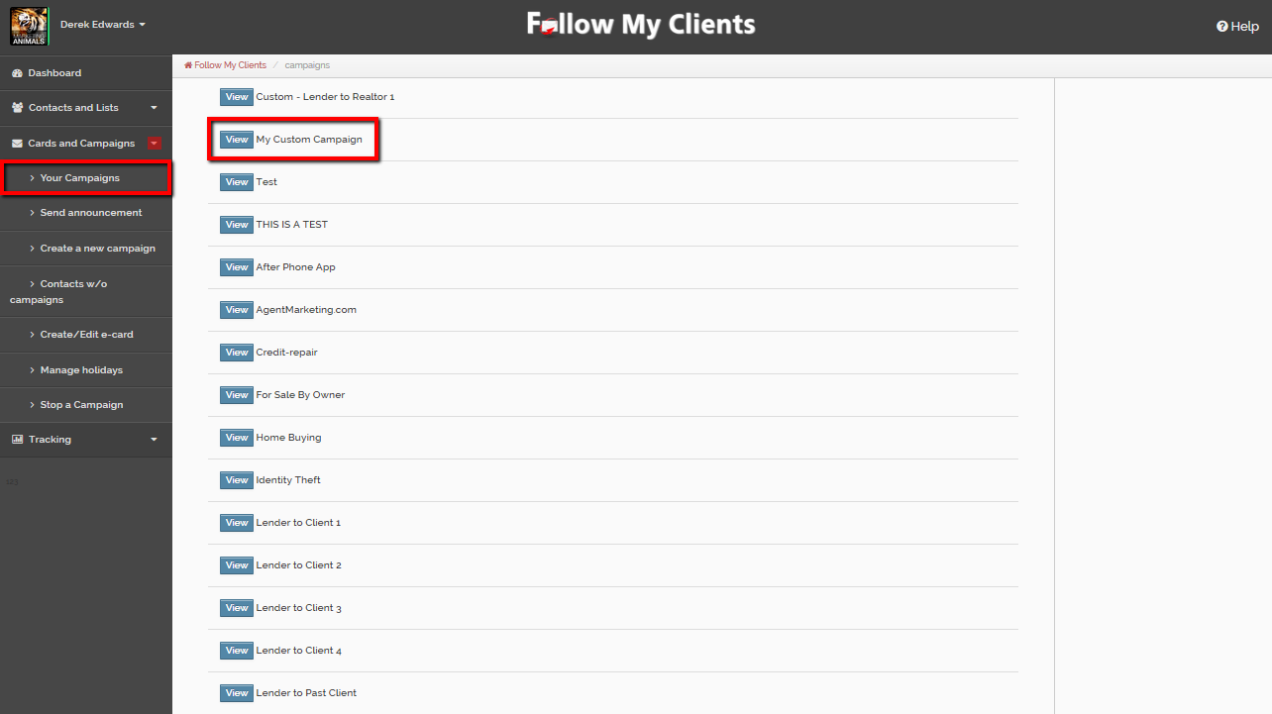
You can then edit or preview the e-cards in that campaign by selecting Cards and Campaigns then Your Campaigns. Find the custom campaign and select view.
If everything looks OK, add that campaign to your prospective list.

Slide 17
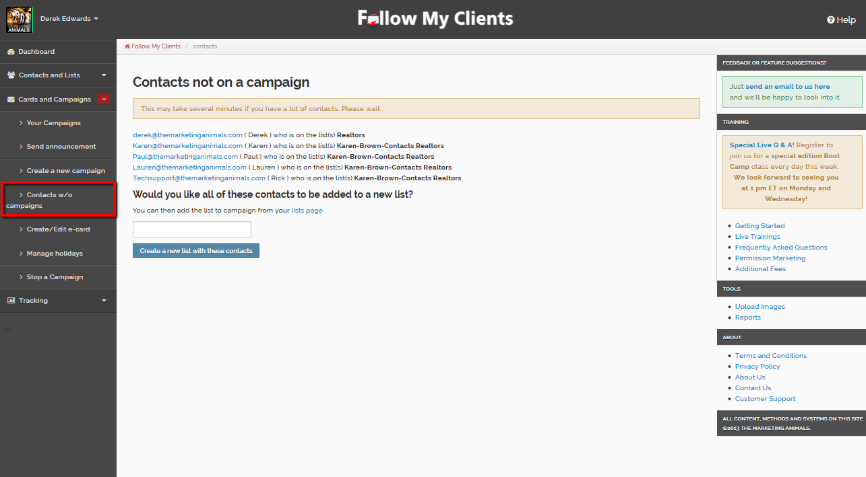
You can view the contacts without campaigns on the Cards and Campaigns tab then Contacts w/o campaigns. Here you can reapply a new campaign one at a time by clicking the contact or add them together as a new list to mass send a new campaign.

Slide 18
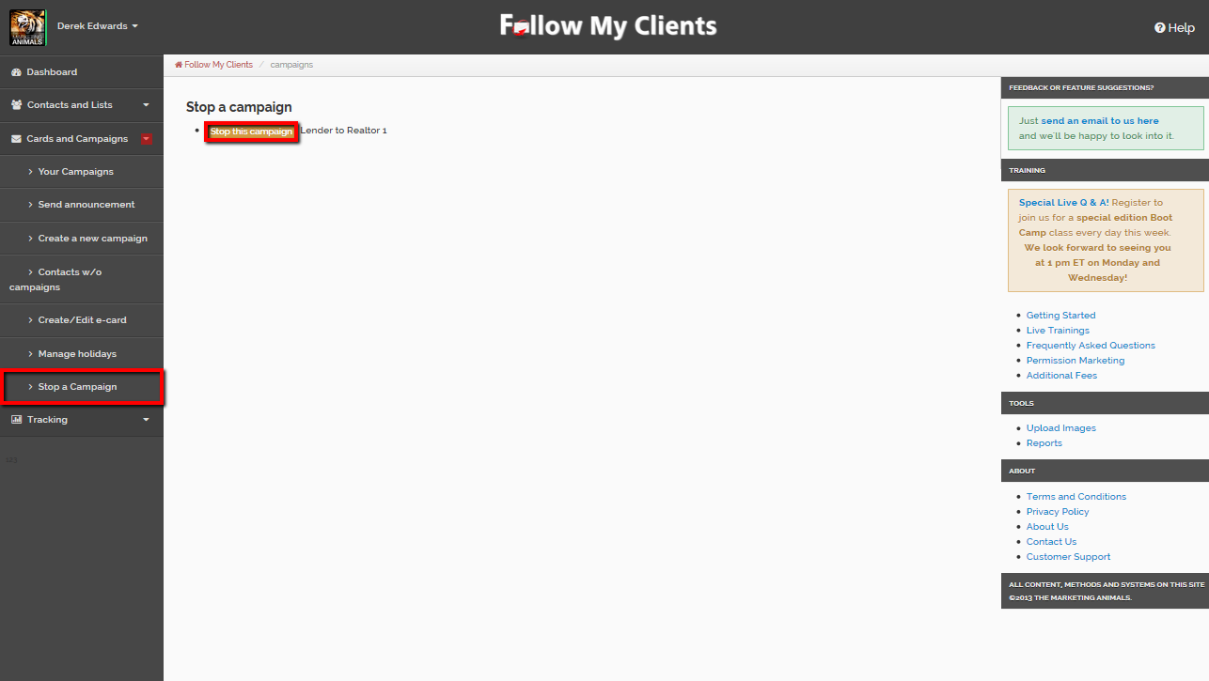
If you would like to apply a new target campaign for your lists. You will want to stop any active campaigns so the contacts in that list who are still on one do not receive double campaigns cards. To do that, select Cards and Campaigns then Stop a Campaign. Find the campaign to stop and click the button for “Stop this campaign”. Wait for your page to fully load.

Slide 19

As mentioned in Step One, you are able to keep track of all the messages you’re sending to your contacts and lists as well as to track each email open and any click through action within the email. For example, Follow My Clients will show if the contact clicked social media icons, websites or any external link for every email sent.

Slide 20
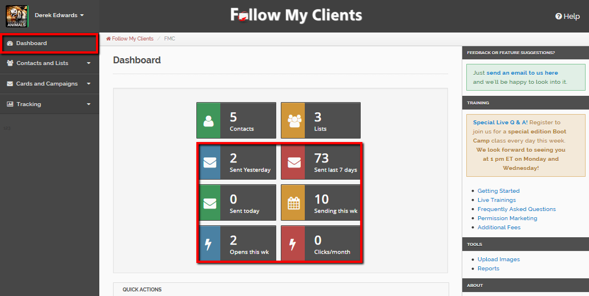
On your Dashboard, you can find the quick access buttons to view the messages already sent and the scheduled messages to be sent. Also, the email opens and the click through.

Slide 21
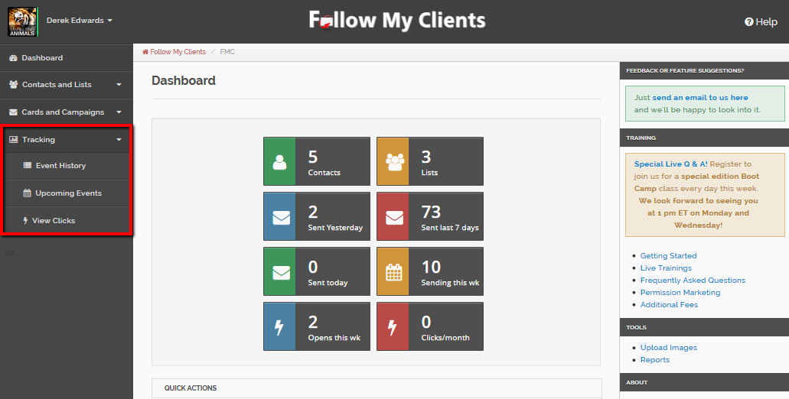
You can also select the Tracking tab on the left to view the messages you have sent, the upcoming scheduled messages to be sent as well as the click through.

Slide 22
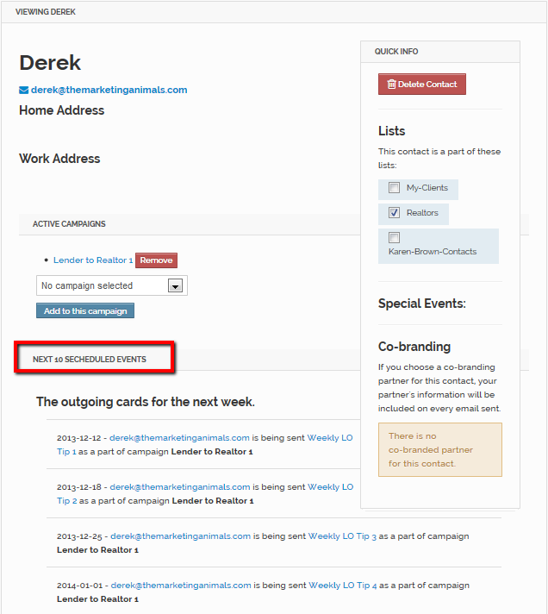
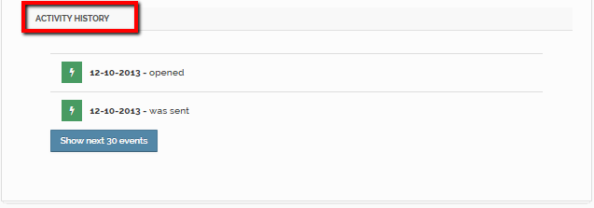
You can also track all of that information for each contact individually by entering the contacts profile page.

Slide 23
You are now ready to apply campaigns to your contacts!
You have completed the Follow My Clients Boot Camp training! You should now be able to use Follow My Clients to automatically keep in touch with your contacts and maintain influence with them!

