Slide 1

Step Three: E-Cards & Announcements

Slide 2

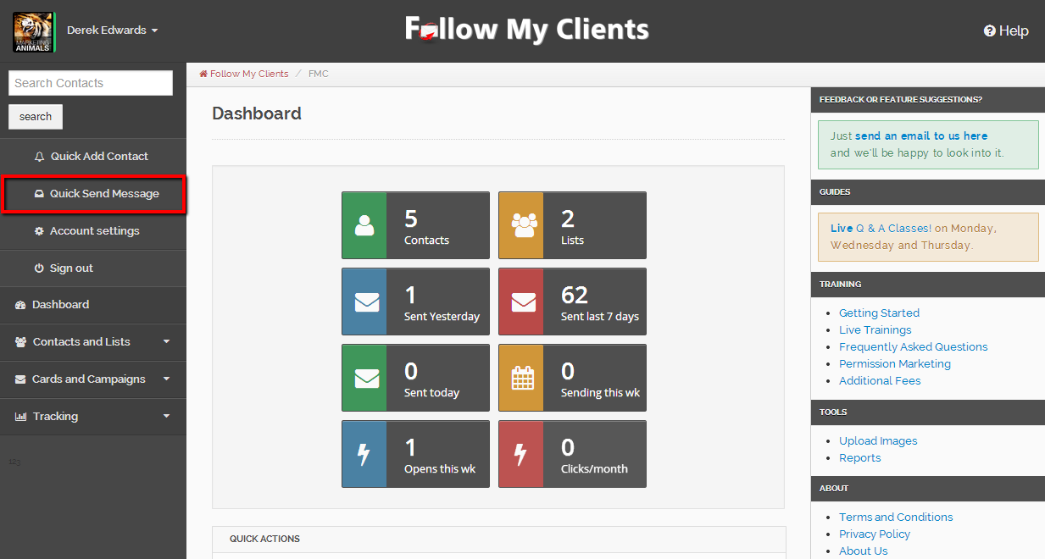
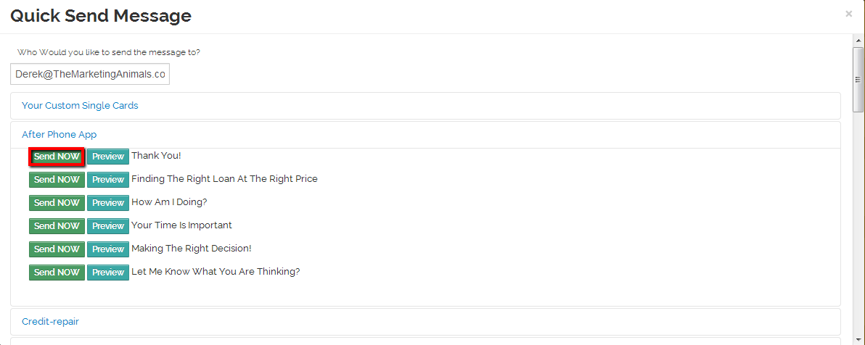
As mentioned in Step One, you can Quick Send Messages. It does exactly what is says and is a great tool to quickly send a single message to any email address. For example, use this tool to send yourself a preview of an E-card before mass sending it out to your contacts.

Slide 3
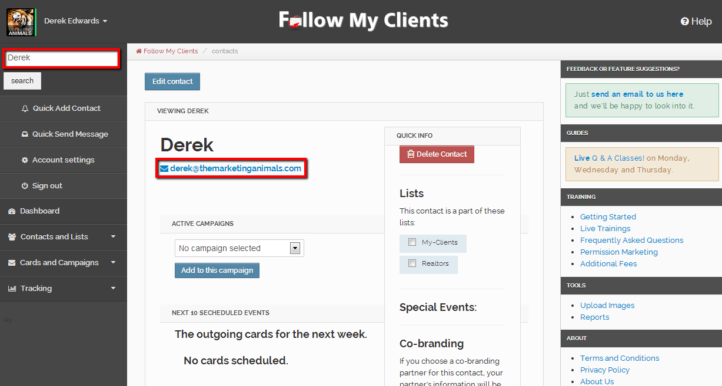
You can also send a single message to any contact by searching for the contact, view the contact and then click the blue email address underneath the contacts name.

Slide 4
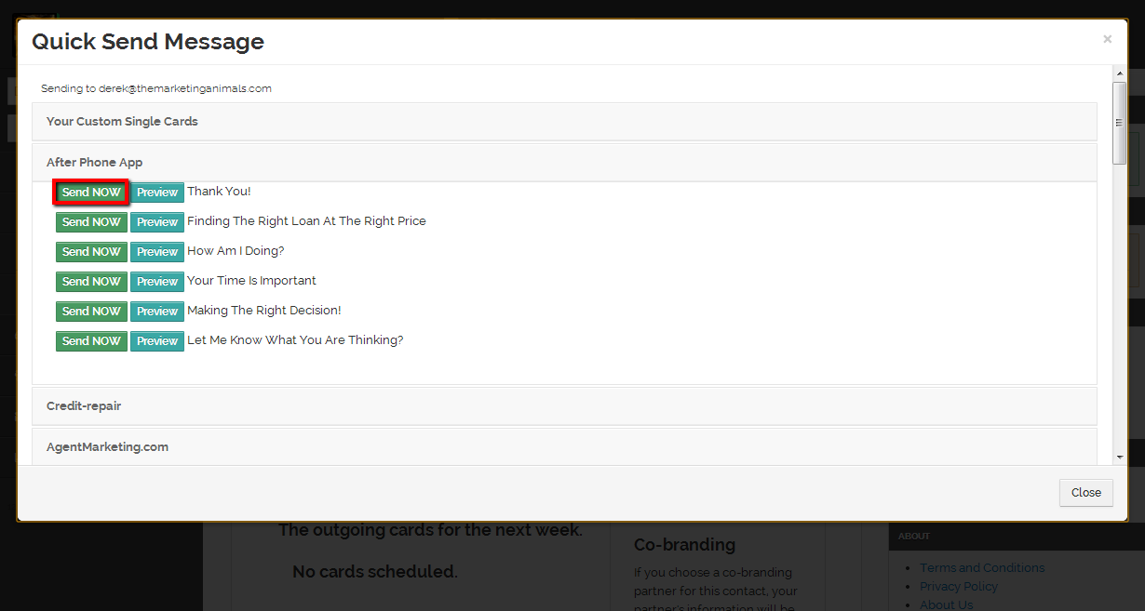
Find the e-card then select “Send Now”. Wait for your page to fully load.

Slide 5

You can then mass send any E-card to your List of contacts by sending them an Announcement. There are two ways to do that.

Slide 6
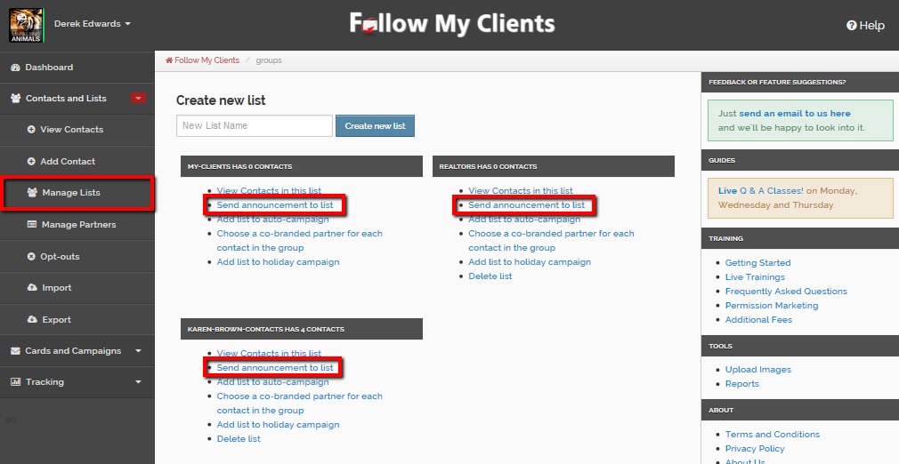
First way is to select Contacts and Lists, then Manage Lists. Under every list there will be a hyperlink to “Send announcement to list”.

Slide 7
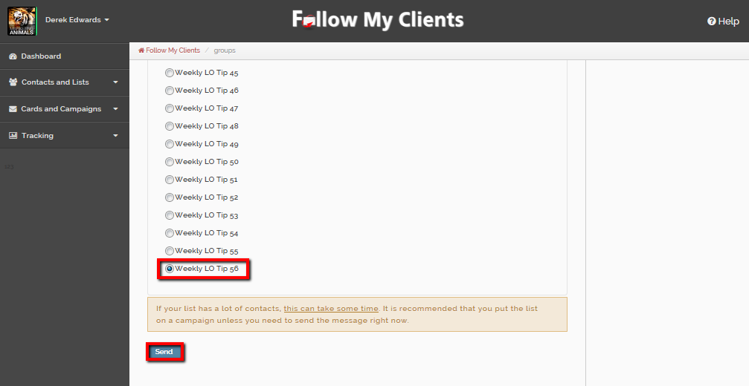
Select the E-card, scroll down and press send. Once again, wait for your page to fully load before exiting or re-directing.

Slide 8
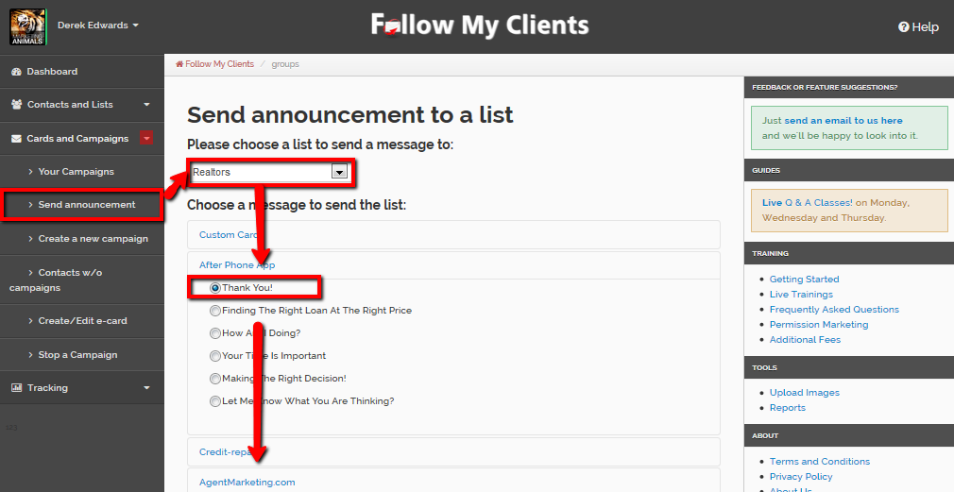
You can also send an announcement by selecting Cards and Campaigns then “Send Announcement”. Choose your List of contacts to send to, then the e-card. Scroll down and press send.
Once again, wait for your page to fully load before exiting or re-directing.

Slide 9
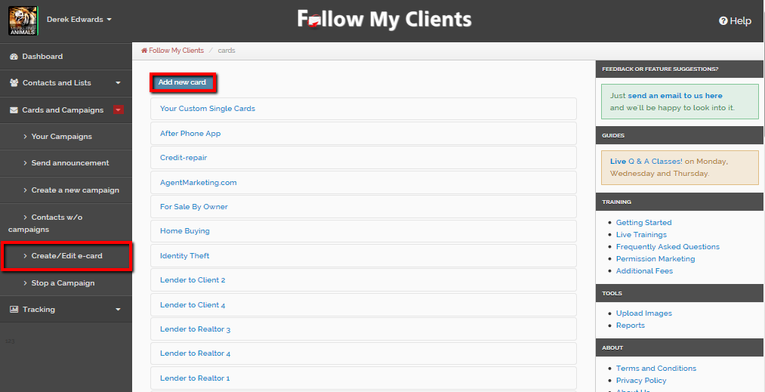
You can create your own custom E-card by selecting Cards and Campaigns then Create/Edit e-card. At the top click “Add new card”.

Slide 10
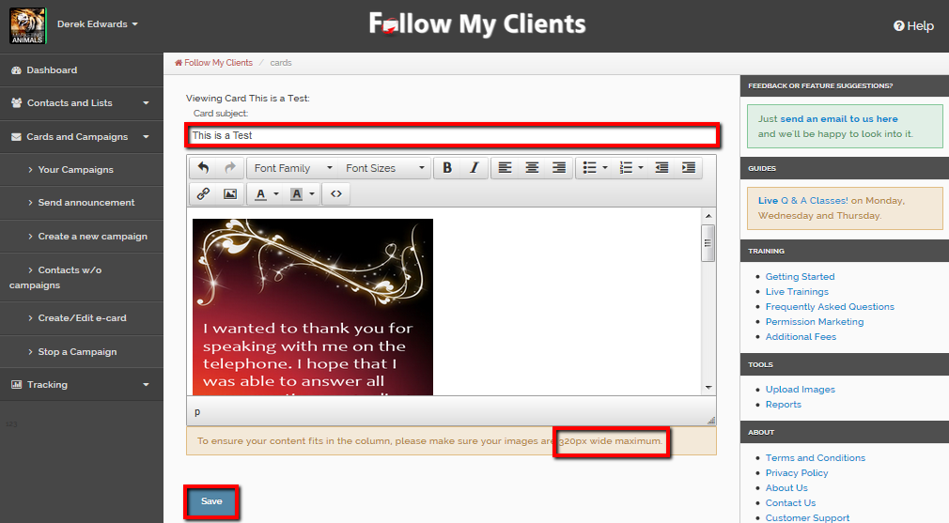
Fill in the title and subject line at the top. Then compose a new E-card. You can add anything you would like as long as it does not exceed 320pixels.
Once you’re done, Save.

Slide 11
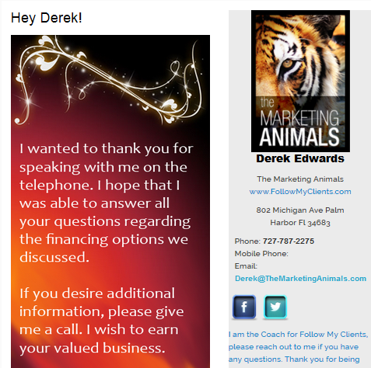
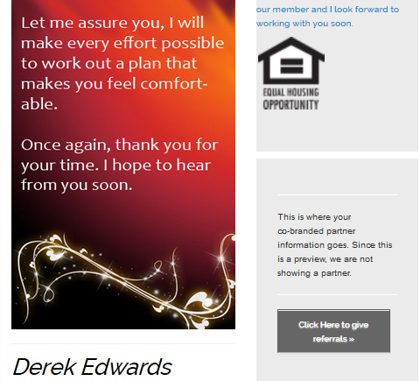
For advanced users, you can create custom templates insides Microsoft PowerPoint or Adobe Photoshop. You just have to make sure the image is no bigger then 320pixels. Then save the image, upload to the Follow My Clients Image hosting site and inserted as a picture image inside the custom e-card through its URL code.

Slide 12
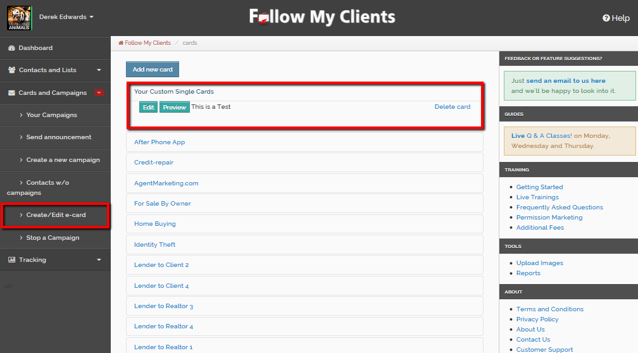
You can preview, edit or delete your custom e-cards at anytime by selecting Cards and Campaigns then Create/Edit e-card. At the top, select the tab for “Your Custom Single Cards” and underneath you will find all your custom e-card messages that you can edit, preview or delete.

Slide 13
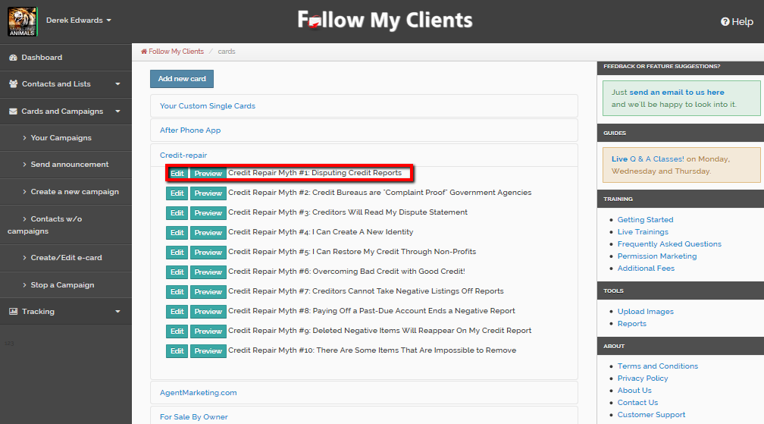
Also, on the Create/Edit e-card page you can preview or edit any pre-written e-card in any campaign. If you edit that e-card and save, Follow My Clients will create a custom duplicate copy of that campaign.

Slide 14
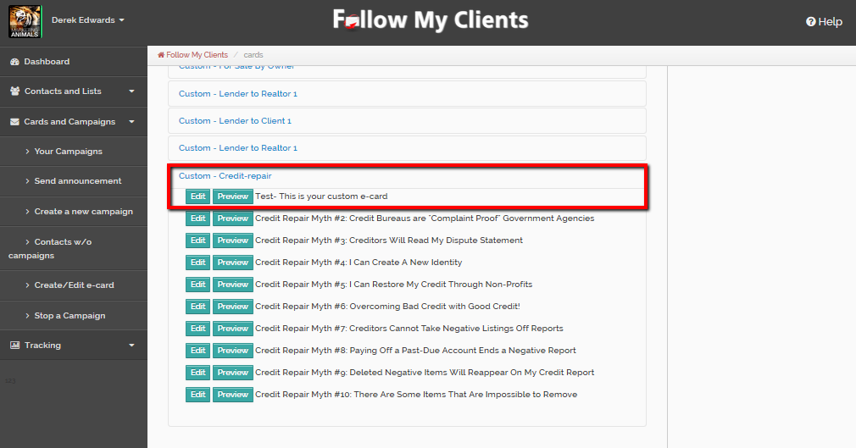
So you must remember that if you edit and save a pre-written e-card, that you use the custom e-card or campaign to send to your contacts and not the original.

Slide 15
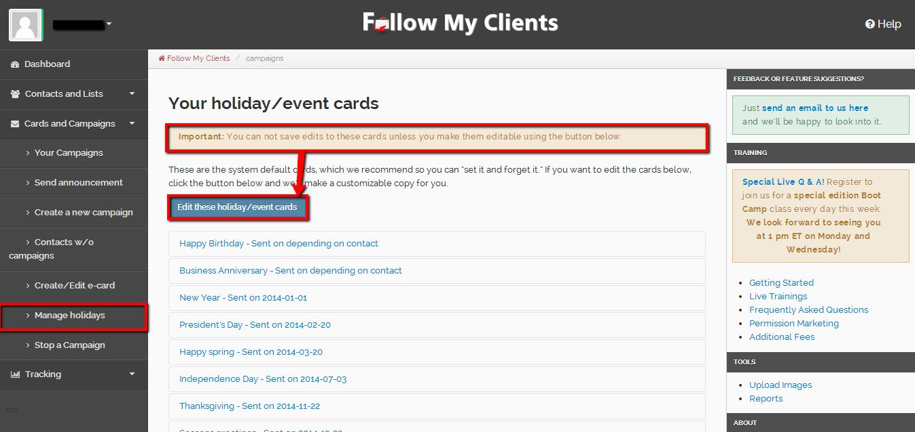
Follow My Clients also offers an automatic Holiday campaign, including Birthdays and Anniversaries if dates are provided. You can select Cards and Campaigns then Manage holidays to edit or preview the e-cards. If you wish to edit them, you must click Edit these holiday/event cards to create a copy for your particular account that is then editable.

Slide 16
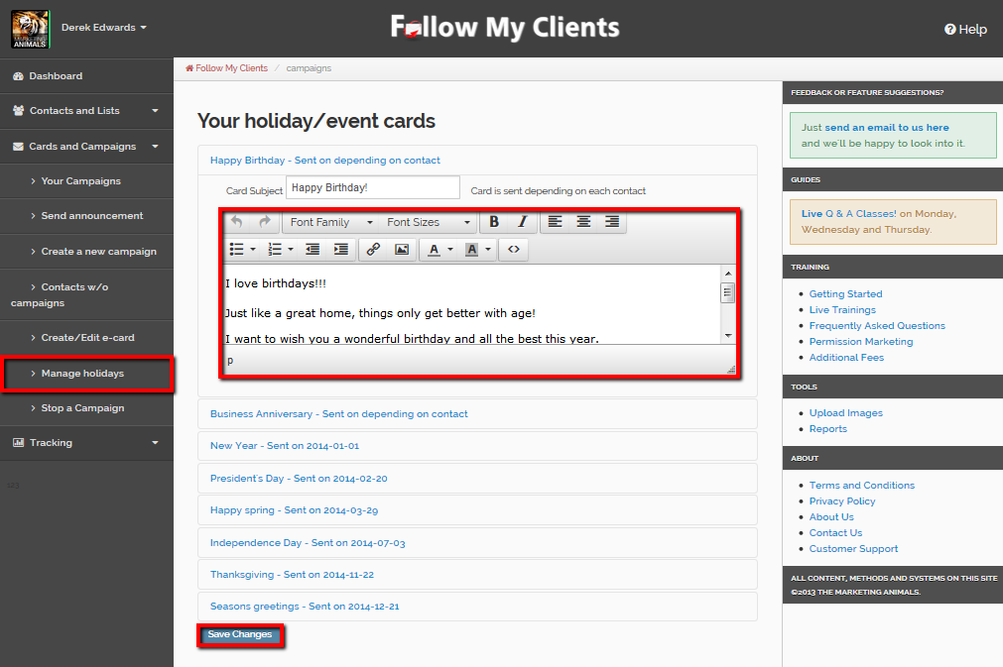
These e-cards are fully customizable and can automatically be sent to your contacts if you opt them in to receive. If you edit the e-card, make sure to save at the bottom.

Slide 17
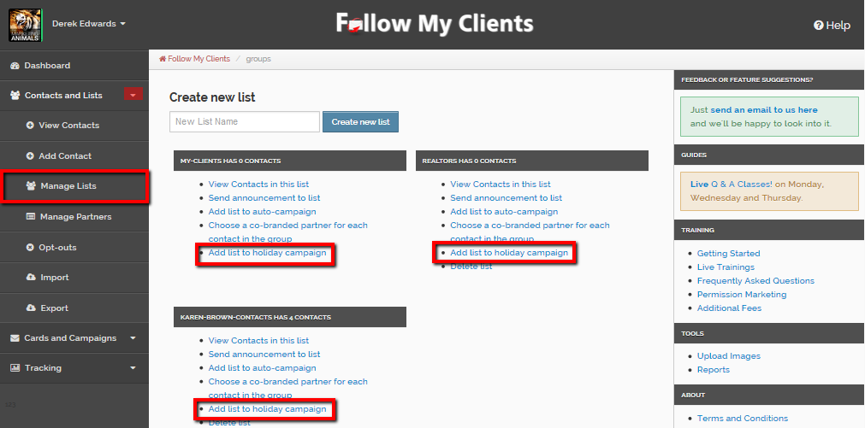
If you have organized your contacts by lists, you can easily mass apply the Holiday program to each list by selecting Contacts and Lists, Manage Lists and under every list, there will be a hyperlink to “Add list to holiday campaign”.

Slide 18
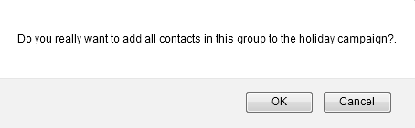
Select OK and wait until your page fully load before redirecting from the page. Repeat that for each List.

Slide 19
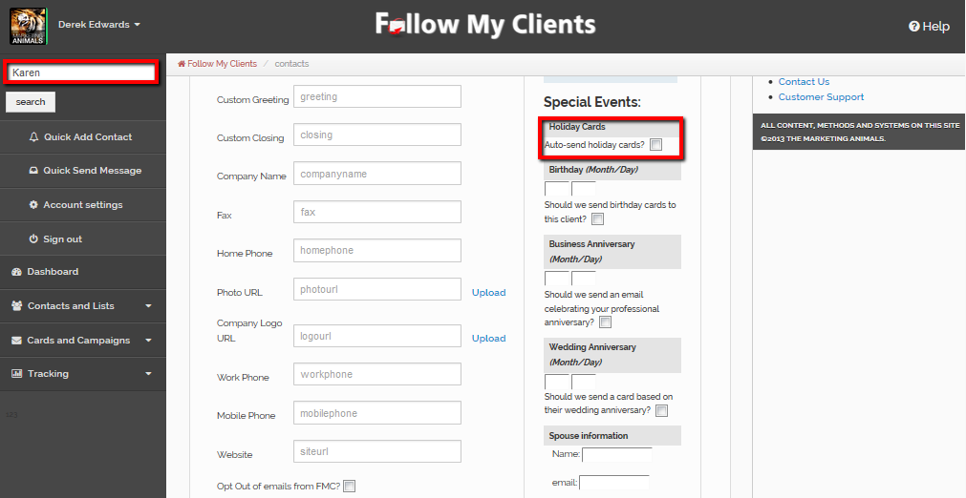
You can also apply the Holiday campaign one at a time, on your contacts profile page. To get there, search for the contact, view contact, edit contact and under “Special Events:” check the box for “Auto-send holiday cards?” then save contact at the bottom.

Slide 20
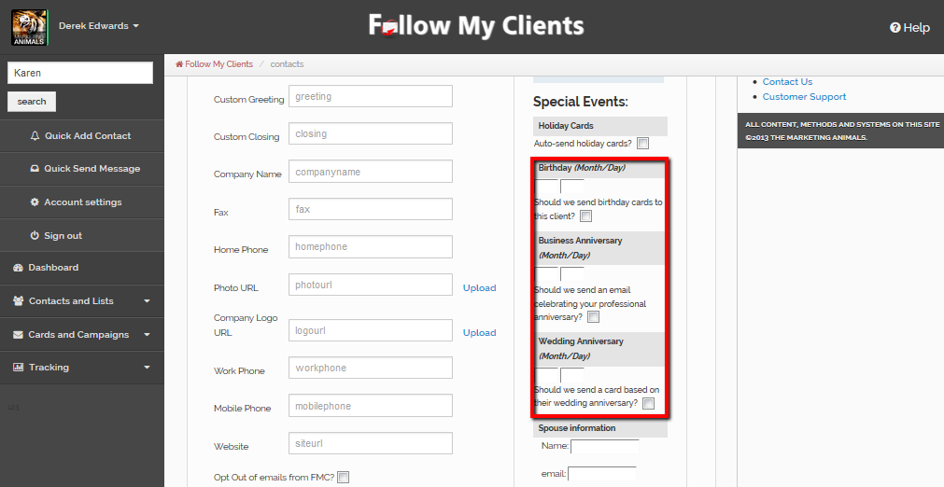
Right under where you select to send the Holiday Cards, you can add the date of the contacts Birthday, Business Anniversary and/or Wedding Anniversary by Month/Day. Then select the box underneath each field to automatically send the e-card.
Make sure to save contact at the bottom.

Slide 21
Message Sent!
Before moving on to Step Four, create a custom E-card and send that as a test email to yourself. Also, edit and apply the Holiday program if you would like your contacts to automatically receive it.

