Slide 1

Step One: Introduction

Slide 2

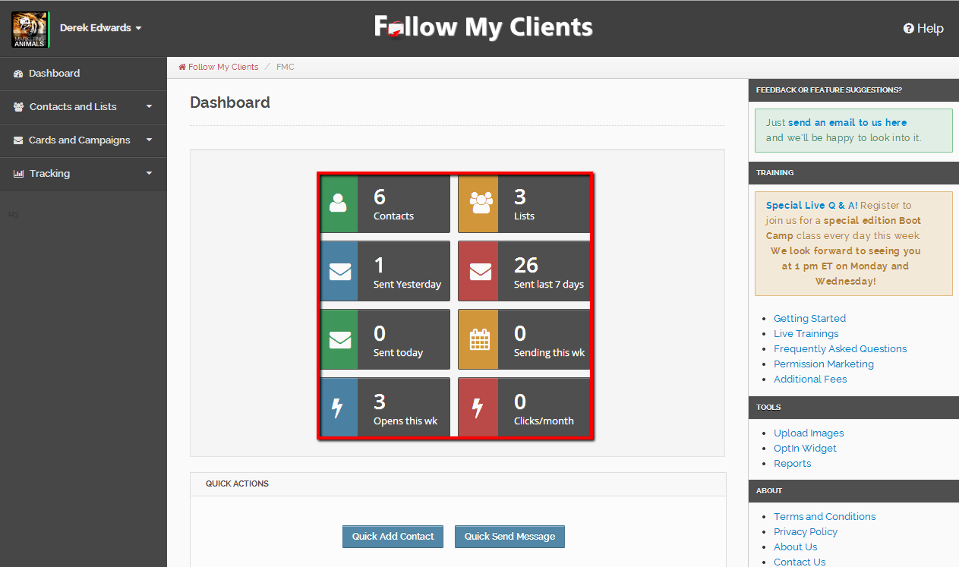
Welcome to Follow My Clients! Once you log in, on the home page is your dash board. Here you will find your quick access buttons to basic features such as viewing your contacts, viewing your lists, viewing the messages you have already sent, the messages scheduled to be sent and where you can easily track all of them.

Slide 3
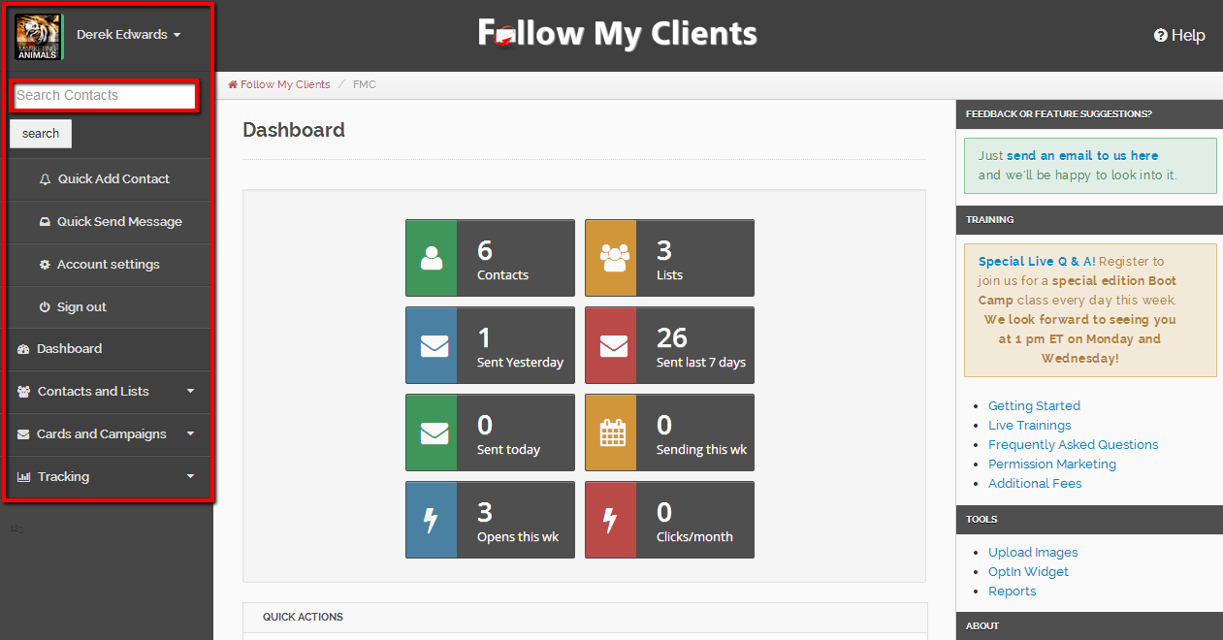
On the left, this panel organizes all of Follow My Clients features into drop down boxes and tabs. At the top you will see your name, if you click the drop down arrow next to your name, you are able to search for any contact by name or by email that are inside your account.

Slide 4
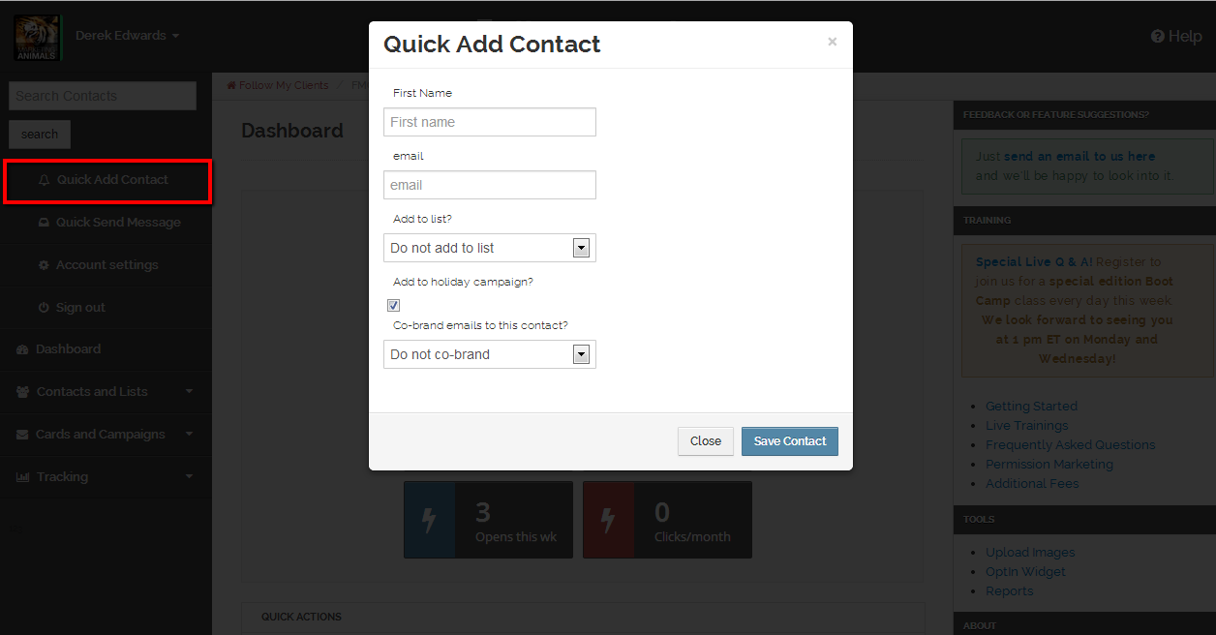
Under that, you can Quick Add Contacts into your account which requires only the necessary information to market with.

Slide 5
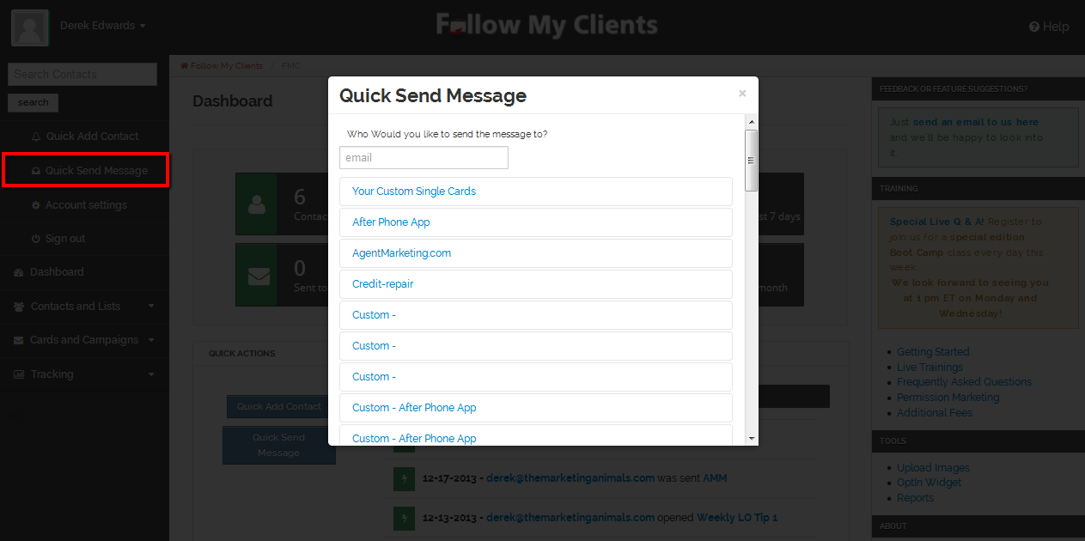
Underneath that, you can easily send Quick Messages to any email address. For example, use this tool to send yourself a preview of an email before mass sending it out to your contacts.

Slide 6
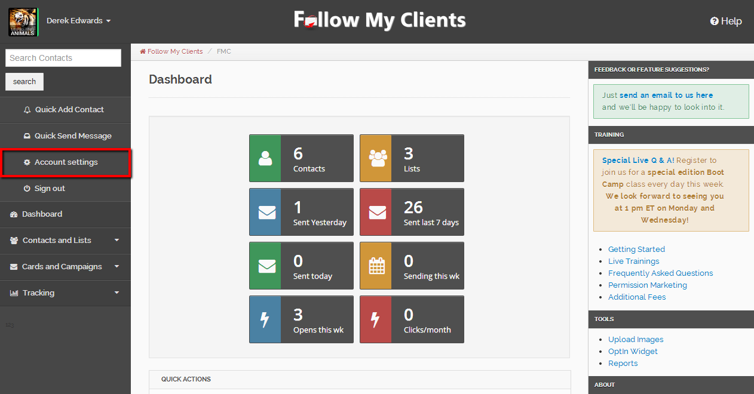
Under that you can view and edit your Account Settings and below that you can sign out. The first thing you want to do is edit your Account Settings.

Slide 7
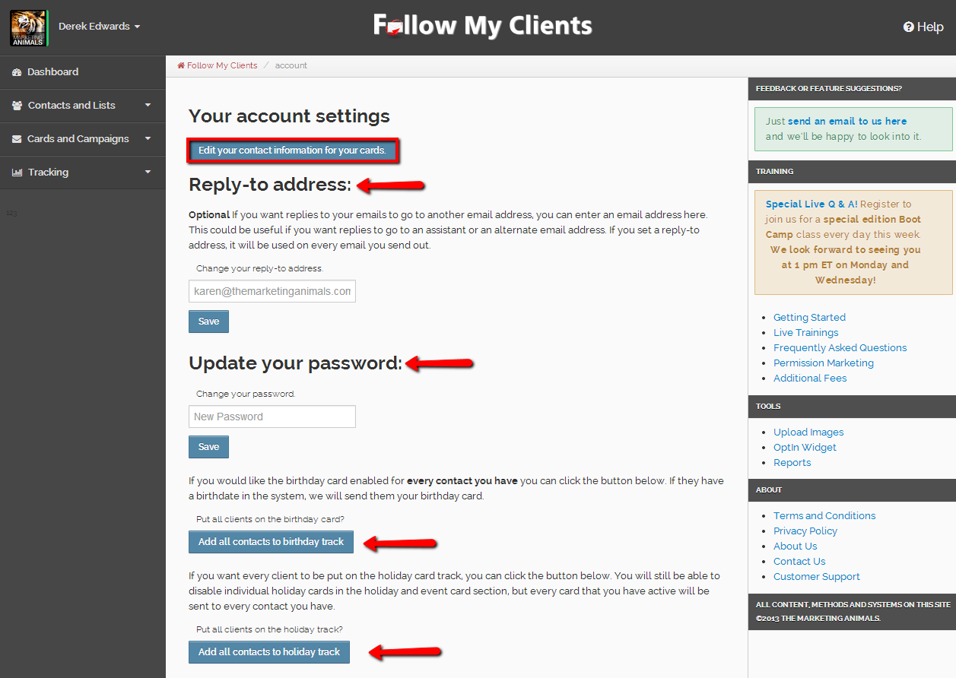
On this page, you can change the email address that your contacts reply to, update your account password and once you have your contacts imported can easily add all your contacts to the automatic Holiday and Birthday program. After reviewing this page, select the button at the top to “Edit your contact information for your cards”.

Slide 8
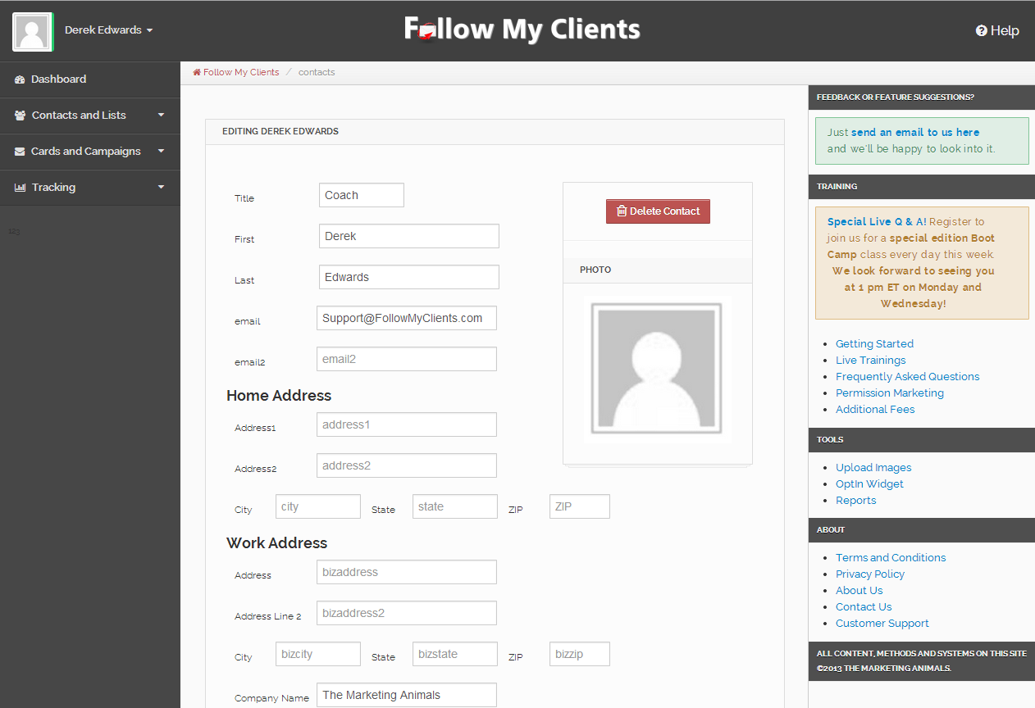
On this page you can customize your branding template that is displayed on every email sent. Begin by filling in the basic information. Leave the box blank if you do not want that information shared.

Slide 9
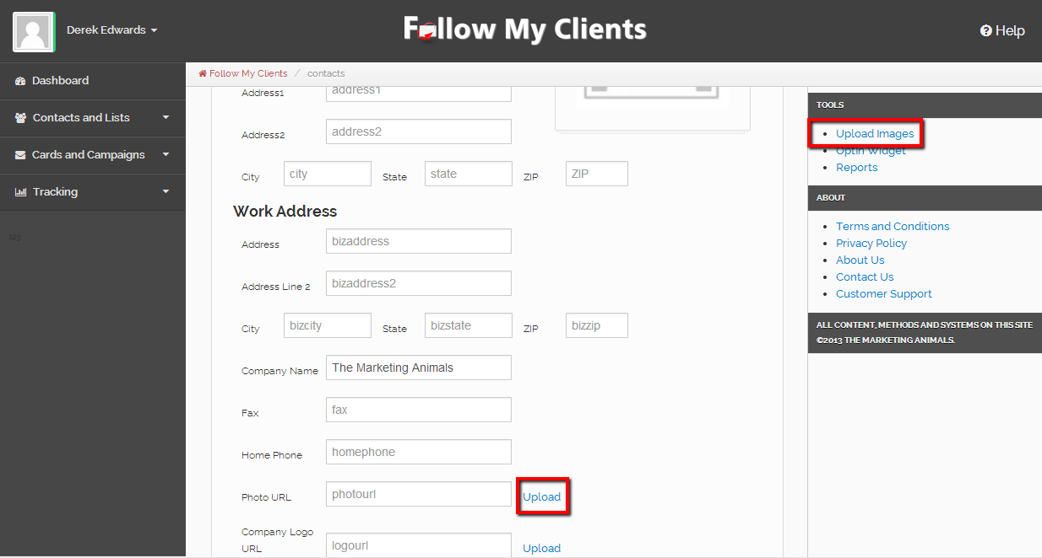
After you have completed your basic business information, you can add your picture. To do that, next to the box called “Photo URL”, click the blue hyperlink for upload. You can also upload images from the tools section on the right.

Slide 10
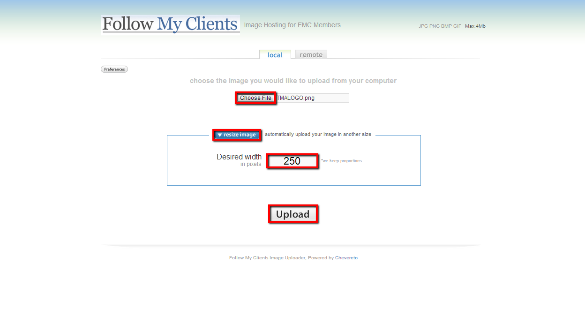
1.
2.
3.
4.
A new tab will open on your browser and you will be redirected to the Follow My Clients image hosting site. (1.) Browse for your image, once you have found it, click the image then click open. To make sure that the image formats properly on the email, (2.)we need to resize the image to (3.)250. Use a lesser number if you would like a smaller image, if the image is already smaller then 250 pixels, you will not have to resize it. (4.)Then click upload.

Slide 11
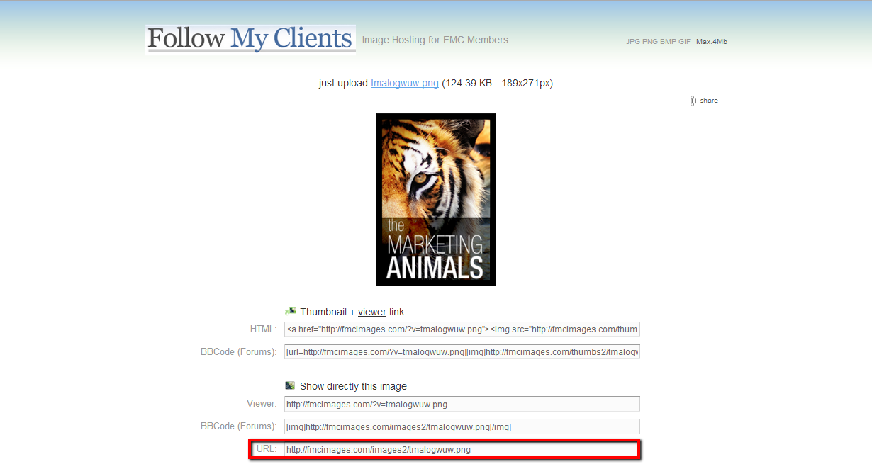
Once the image is uploaded, copy the URL code at the bottom.

Slide 12
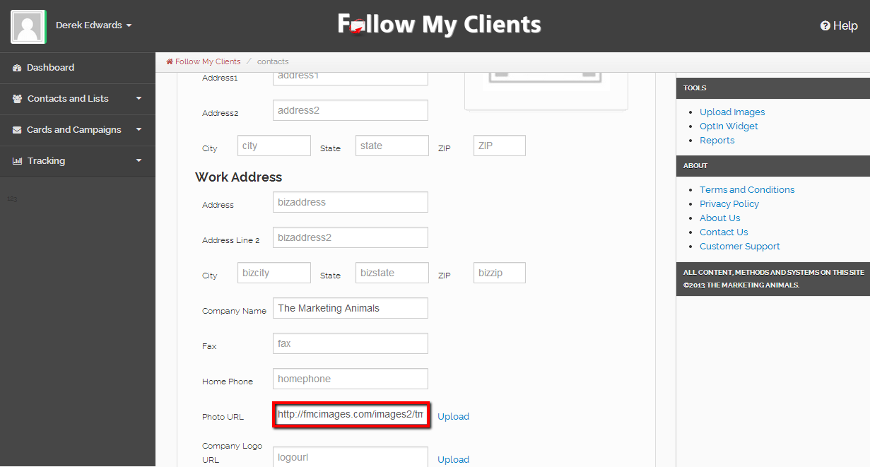
Go back to the Follow My Clients tab on your browser and paste that code into the Photo URL box. You can repeat that process for your company logo.

Slide 13
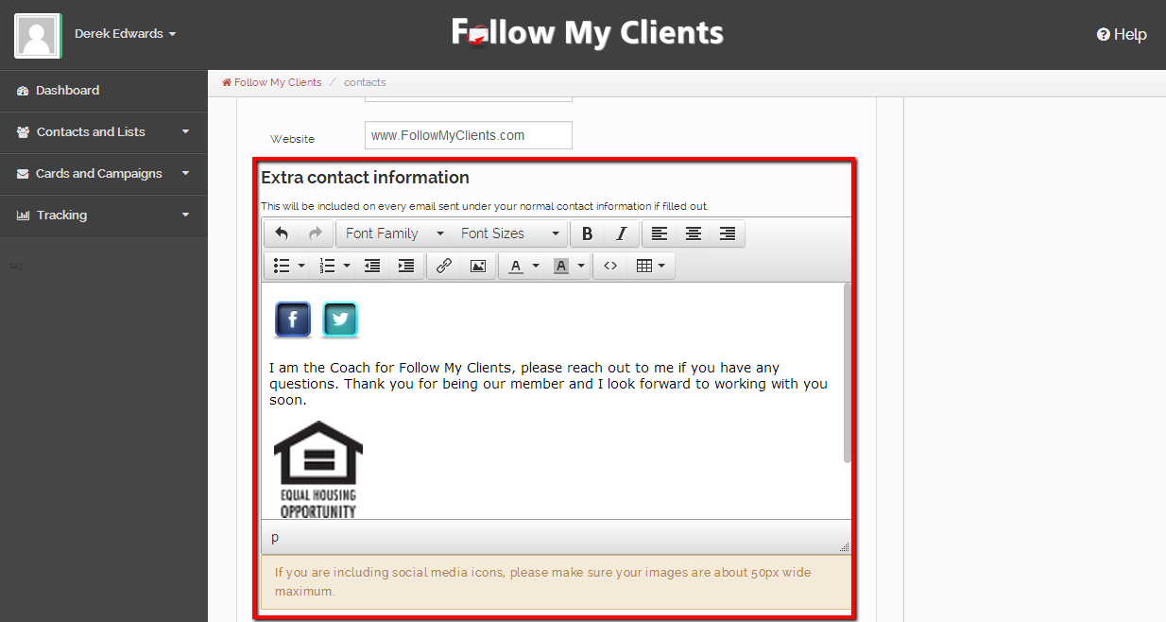
After adding your picture, scroll down and you will see a body box called Extra contact information. This is an open field on your branding template that gives you the freedom to add anything you would like, such as a description about yourself, social media icons, trigger buttons, extra logos such as the equal housing opportunity, or anything, as long as it does not exceed 250 pixels. Lets start with social media icons!

Slide 14
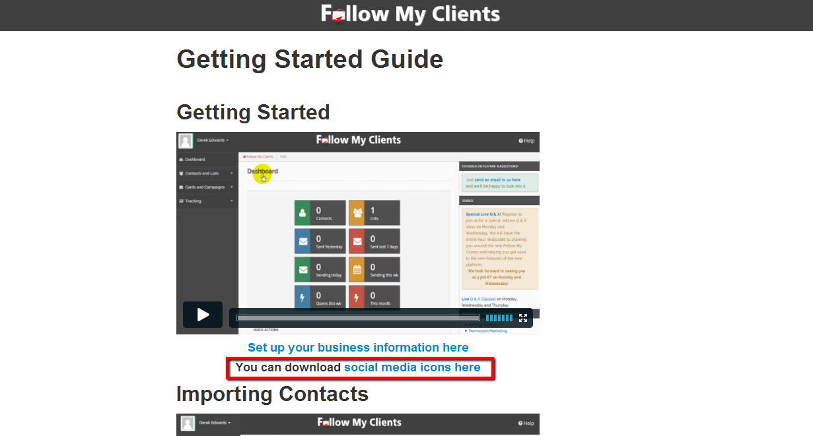
Inside your account, on the right or inside the help feature on the top right, click the link for Getting Started. Then click the link to download social media icons. You can also Click Here to access our pre-downloaded social media icons.

Slide 15
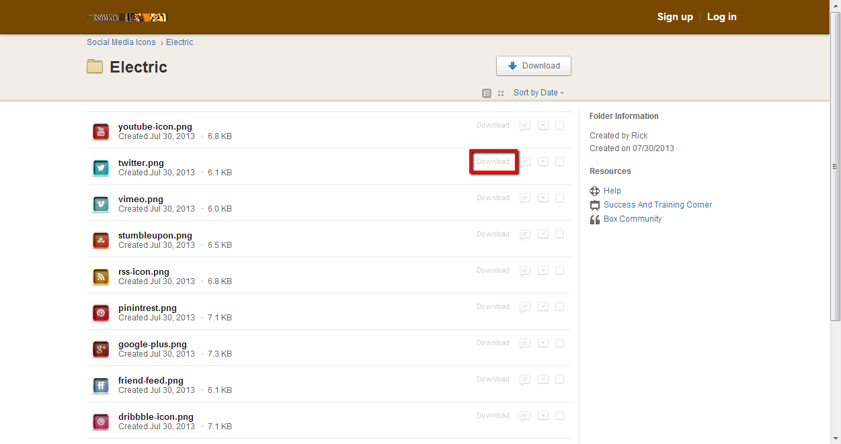
We have provided a variety of styles so browse through the different folders to find the icons you like. Once you find the icon you would like to include, download the icon onto your computer.

Slide 16
Go back to the Follow My Clients tab on your browser and select the hyperlink for upload images.

Slide 17
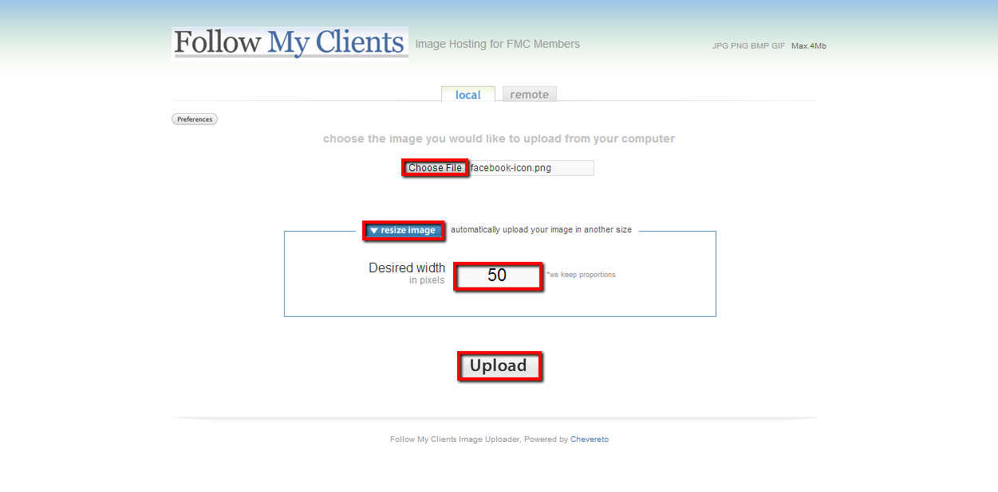
1.
2.
3.
4.
Browse for your icon, open it, resize to around 50, then upload.

Slide 18
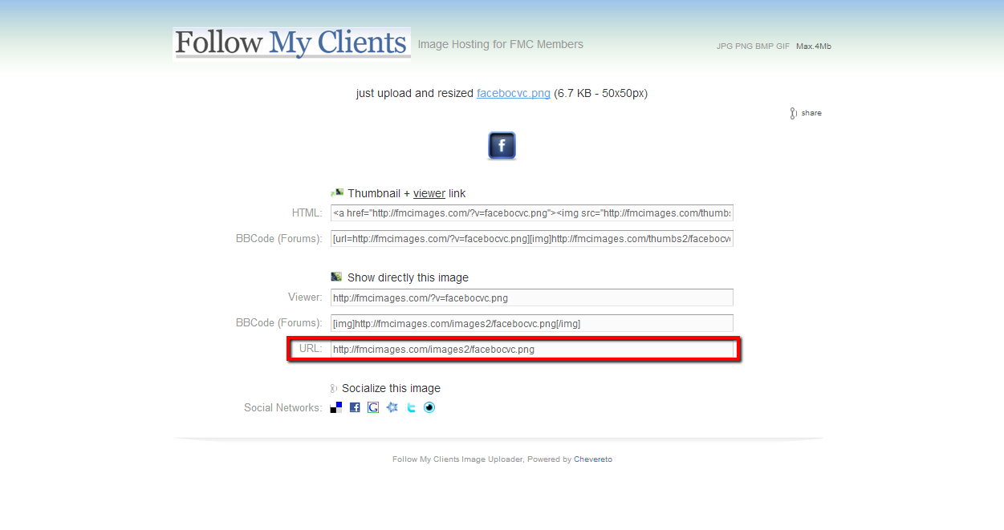
Copy the URL code at the bottom.

Slide 19
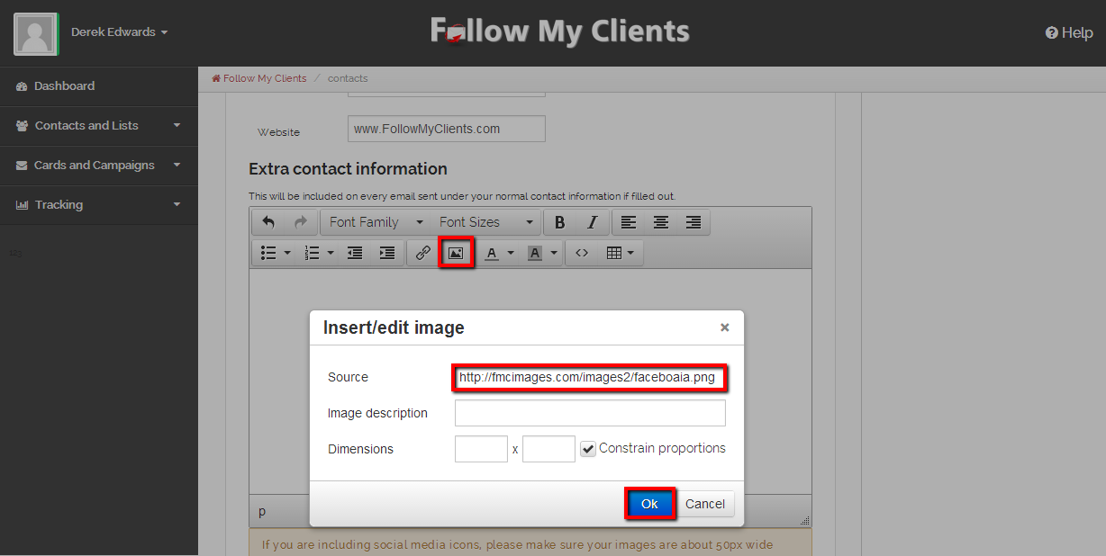
1.
2.
3.
Go back to the Follow My Clients tab on your browser and inside the Extra contact information box, (1.)click the icon in the editor for insert/edit image and (2.) paste inside the box titled source, then (3.)press ok.

Slide 20
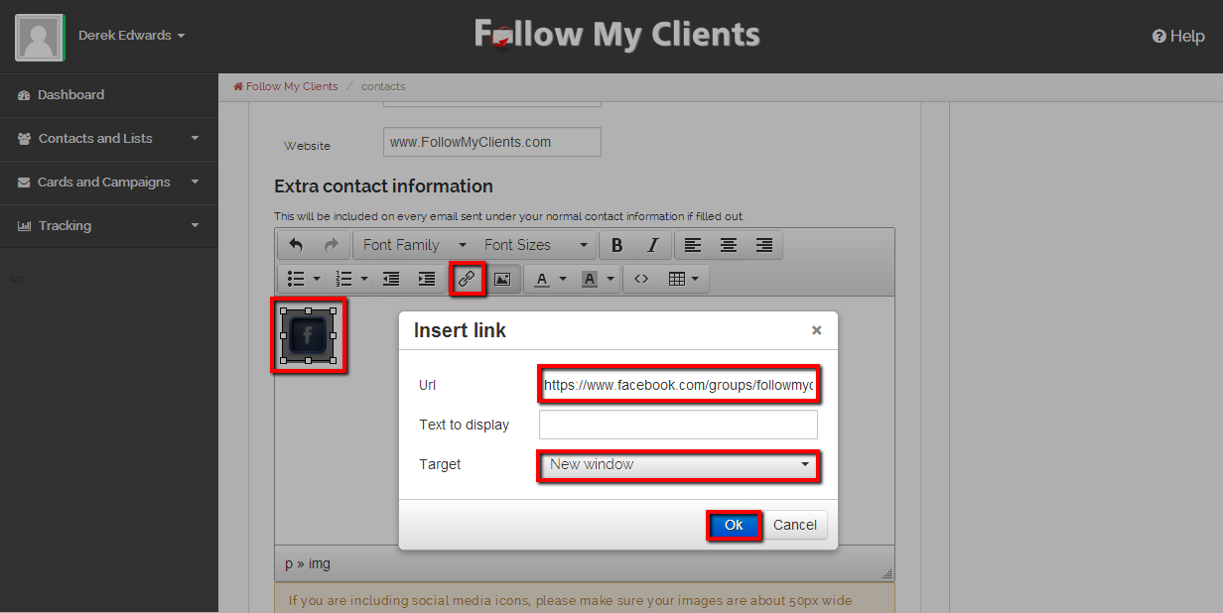
2.
1.
3.
4.
5.
Now we need the URL address to the website you want this icon to link to. Copy it, then go back to your Follow My Clients tab on your browser. (1.) Click the social media icon (2.) Click the icon for insert/edit link inside editor (3.) Paste the website address inside the URL box (4.) Make sure to add the target in a new window so that your contacts do not redirect from their inbox after clicking your icon (5.) Then press ok.

Slide 21
Repeat that process to include all of your information. Make sure to add these icons and link them one at a time so that you do not accidentally link them incorrectly. Once your done, scroll down to the last editor box.

Slide 22
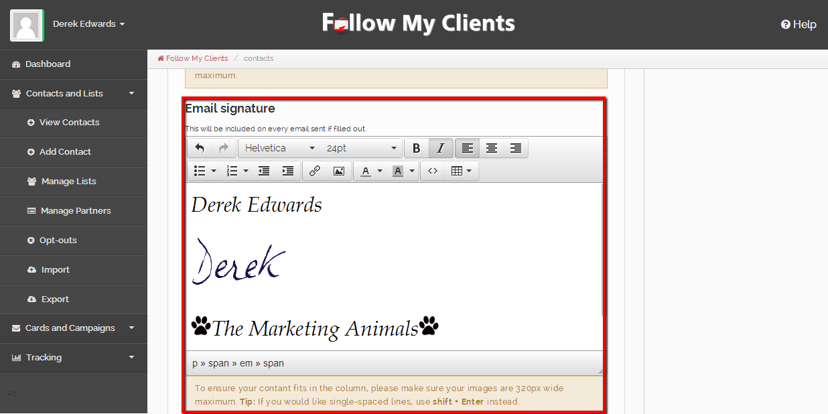
The last editor box is for your Email Signature. You can add anything you want inside this box, as long as it does not exceed 320 pixels. For example, if you have a scanner, you can scan an copy of your signature and repeat the process for adding social media icons but resize your signature to about 150 instead. Then your signature will be displayed on every email sent. Looks really awesome!

Slide 23
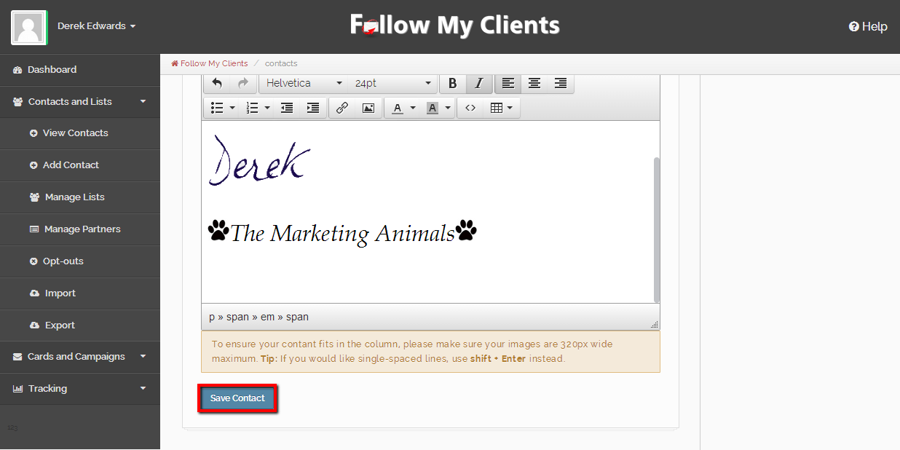
Once you are done click “Save contact” at the bottom.

Slide 24
You have successfully completed your branding information and can now begin to gather and organize your contacts to import!

